Slide 1


Preliminary Findings from a Trial of a School-based Mindfulness intervention in Rwanda.
The 4th International Conference on "Re-shaping Education for Sustainable Development.
Presenter: Dr Jean Paul Bikorimana
University of Rwanda/Aberdeen University
Kigali, 17 June 2026

Slide 2
Background
Mental wellbeing is fundamental to children's educational success and overall development (Clarke et al., 2011; Dodge et al., 2012).
Mental health challenges are increasing among children and adolescents, particularly in Sub‑Saharan Africa (Cortina et al., 2012).
In Sub‑Saharan Africa, about 1 in 7 children/adolescents experience a mental health condition, impacting academic performance, social functioning, and long‑term wellbeing.
School‑based interventions can enhance psychological and emotional wellbeing, contributing to educational achievements (Barry et al., 2017; Weare & Nind, 2011; Fazel et al., 2014).
This study aims to evaluate the effectiveness of a whole-school mindfulness intervention for improving child and adolescent wellbeing in Rwanda and Ethiopia.

Slide 3
Problem Statement
CA mental health is an educational priority, however, the evidence indicates a burden of psychological distress among CA (Cecilia, et al., 2024).
Mental wellbeing challenges pose a threat to learning, educational attainment, and healthy development.
School-based mental health programs are being implemented in Rwanda, but there remains a need for complementary and evidence-based approaches.
School-Based Mindfulness Interventions (SBMIs) show promise in improving emotional wellbeing, resilience, stress management, and school climate, with most studies conducted in high-income countries (Abbott, 2024)
Evidence on SBMIs remains limited in African contexts, underscoring the need to evaluate their effectiveness and cultural appropriateness in Rwanda.

Slide 4
Research objectives
Overall Objective:
To evaluate the effectiveness a whole school-based mindfulness intervention for improving child and adolescent wellbeing in Rwanda and Ethiopia.
Specific Objectives:
Test feasibility of study tools
To assess the status of the mental wellbeing of CAs before during and after the intervention;
To identify the underlying context and intervention mechanisms explaining the effects of the mindfulness intervention and compare these with those identified in the literature;
To evaluate the responsiveness of CA and Teachers to mindfulness intervention
To determine the acceptability and affordability of the mindfulness intervention

Slide 5
Theoretical Framework
Critical Realism framework — explaining how, why, and for whom interventions succeed or fail, and under what circumstances.
The framework was informed by the following theories:
Bhaskar’s Realist Theory — emphasizes three layers of reality: empirical, actual, and real (Bhaskar, 1975).
Archer’s Morphogenic Approach — exploring the dynamic interaction among structure, culture, and agency (Archer, 1995).
Laminated System — highlighting the interplay of biological, intrapersonal, interpersonal, and social structures shaping outcomes.

Slide 6
Methodology
Critical Realist Cluster Randomized Controlled Trial applying a whole-school mindfulness intervention approach.
Quantitative and qualitative research approaches.
62 teachers and 923 pupils from control (512) and intervention (411) schools participated in the study.
The study took place in Burera district schools: GS Rugarama (control) and Rwasa (intervention).
Data were collected at baseline, midline, and endline using psychometric tools, Interviews, FGDs, and observation.

Slide 7
Methodology
The data analysis followed abductive and reproductive reasoning.
Independent samples T test and Mixed design with repeated measures ANOVA were used for quantitative analysis using SPSS, version 30.
Qualitative template approach was used to analyse qualitative data using Nvivo.

Slide 8
Key preliminary results: Teachers
Outcome | Group comparison | Mean difference | 95% CI |  | Sig
Life satisfaction | Baseline: Intervention vs control | 0.42 | -.612 | 1.460 | .416
 | End-line: Intervention vs control | 3.63 | 2.977 | 4.295 | <.001
Classroom management | Intervention: baseline & end-line | -1.34 | -2.522 | -0.166 | .026
 | Control: baseline & end-line | -0.53 | -1.924 | 0.855 | .44
Relationship between teachers and pupils | Baseline: Intervention & control | -1.05 | -1.958 | -0.150 | .023
 | End-line: Intervention & control | 0.78 | -0.121 | 1.683 | .088
Work related stress | Baseline: Intervention & control | -0.17 | -0.169 | 0.427 | .69
 | End-line: Intervention & control | -1.53 | -2.513 | 0.544 | .003

Slide 9
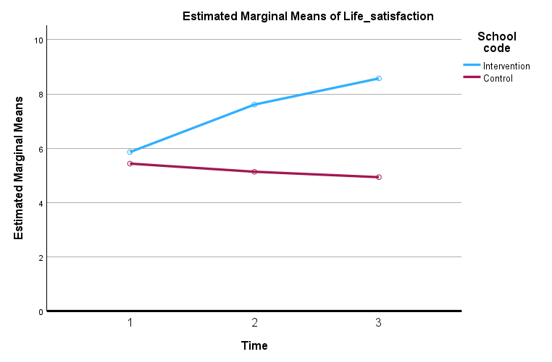
Key preliminary results: Teachers
Teachers' job satisfaction increased over time in the intervention school, whereas it declined in the control school.
Significant effect of time:
F(2,112) = 11.60, p < .001
Significant Group × Time interaction:
F(2,112) = 24.29, p < .001

Slide 10
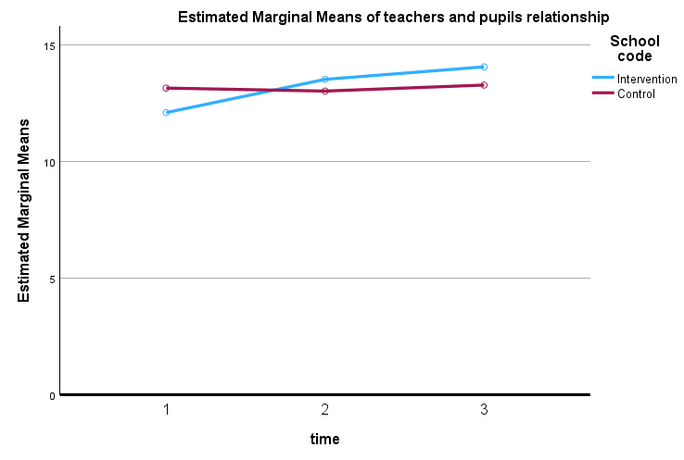
Key preliminary results: Teachers
Teacher and pupils relationship
Teachers in the intervention school reported positive relationships with pupils over time, while scores remained relatively stable in the control school.
The effect of time: F(2, 114) = 7.19, p = .001, and the scores over time changed differed significantly between the intervention and control groups. F(2, 114) = 6.30, p = .003.

Slide 11
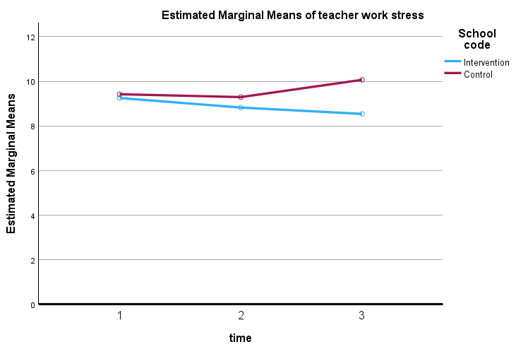
Key preliminary results: Teachers
Work stress
Teacher work stress decreased over time in the intervention school, while stress levels increased in the control school.
No overall change in work stress across the three measurement occasions:
F(2,114) = 0.64, p = .532
We observed significant Group × Time interaction:
F(2,114) = 3.51, p = .033

Slide 12
Key preliminary results: Pupils
Outcomes | Group comparisons | Mean differences | 95% CI |  | Sig
Conduct and emotional difficulties | Baseline: Intervention & control | 2.37 | 1.513 | 3.167 | <.001
 | End-line: Intervention & control | 0.58 | -.253 | 1.408 | .173
Psychological and emotional wellbeing | Baseline: Intervention & control | -.75 | -2.024 | 0.522 | .247
 | End-line: Intervention & control | 0.34 | -0.75 | 1.441 | .536

Slide 13
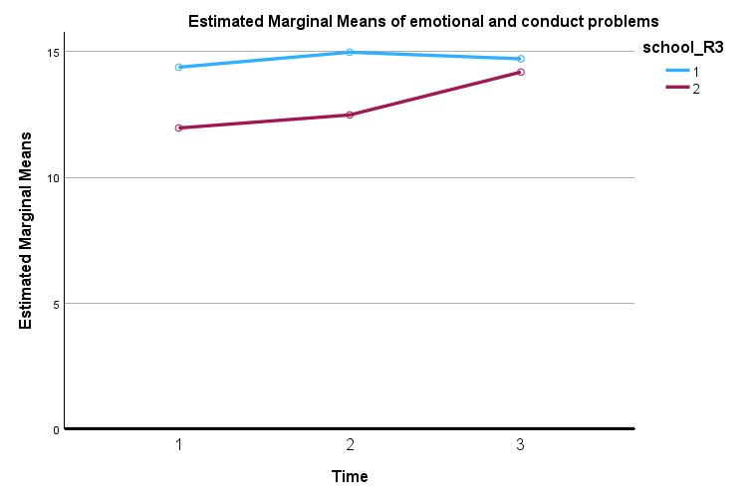
Key preliminary results: Pupil
Conduct and emotional
pupils in the intervention school maintained relatively stable levels of emotional and behavioural difficulties across the study period, whereas difficulties increased progressively in the control school.
Significant effect of time:
F(2,1520) = 15.57, p < .001
Significant Group × Time interaction:
F(2,1520) = 11.74, p < .001

Slide 14
Key preliminary results: Teachers
During end-line interviews, teachers shared how mindfulness practices help them to cope with their emotions, enhancing their focus on their job.
“When I start feeling angry...I practice three-minute breathing, and after doing it, I calm down.” (……..)

Slide 15
Key preliminary results: Pupil
During the end-line interviews with pupils, they described the how mindfulness practices helped them to control their emotions and behaviours, becoming calmer and attentive, contributing to wellbeing.
“The class is calm now, we concentrate better, and our performance has improved” (Class, age, gender, ..)
“School feels safer, we are welcomed with the sound of music and drums." (……)

Slide 16
Conclusions
The school-based mindfulness intervention improved wellbeing outcomes for both teachers and pupils.
Among teachers, mindfulness increased life satisfaction, strengthened teacher–pupil relationships, and reduced work-related stress.
Among pupils, emotional and conduct difficulties remained relatively stable in the intervention school while worsening over time in the control school, suggesting a protective effect of mindfulness.
These findings are consistent with previous evidence that mindfulness enhances wellbeing, emotional regulation, resilience, and positive social relationships in school settings (Jennings & Greenberg, 2009; Emerson et al., 2017; Dunning et al., 2019).
Preliminary findings suggest that mindfulness can support wellbeing and positive school environments. Further analyses will explore how these changes are achieved.

Slide 17


Acknowledgement
Funding: The author(s) declare financial support was received for the research, authorship, and/or publication of this article. This research was funded by the National Institute for Health and Care Research (NIHR 133712) using UK aid from the UK Government to support global health research.
Disclaimer: The views expressed in this publication are those of the author(s) and not necessarily those of the NIHR or the UK government, the Court of the University of Aberdeen, the Board of Directors of the University of Rwanda, the Board of Directors of Addis Ababa University, or our International Advisory Board.
Copyright: This is an open-access PPT distributed under the terms of the Creative Commons Attribution License, which permits unrestricted use, distribution, and reproduction in any medium, provided the original author and source are credited.

