Slide 1


Child and Adolescent Mental Health in Rwanda: A Political Economy Analysis of Priority-Setting, Institutions, and Implementation
Lucia D'Ambruoso, Ivan Gahima, Dorothy Tukahabwa, Clarisse Marie Claudine Simbi, Laetitia Nyirazinyoye, Clementine Kanazayire, Darius Gishoma, Emmanuel Mwizerwa, François Nkurunziza, Wenceslas Nzabarirwa Pamela Abbott
Presenter: Dr. Ivan GAHIMA
University of Rwanda – College of Medicine and Health Sciences | University of Aberdeen, UK
Email: i.gahima@ur.ac.rw/ ivan.gahima@abdn.ac.uk
4th UR-CE international Conference on “ Re-shaping Education for Sustainable Development
Date: 17th June, 2026

Slide 2
Background
Child and adolescent mental health is shaped by individual risk and wider political, economic, and institutional conditions.
Childhood and adolescence are critical periods, with mental disorders contributing heavily to non‑fatal disease burden.
Treatment gaps are especially wide in low‑ and middle‑income countries.
Social determinants (poverty, violence, gender inequality, childhood adverse experiences) and post‑conflict hardship constrain services and increase need.
In low‑income and post‑conflict settings, children face multidimensional hardship and Psychosocial adversity, weak specialist provision, fragmented service delivery, and competition over public priorities.

Slide 3
Problem Statement
Much of the global policy response has focused on service deficits: shortages of specialist staff, underinvestment, limited access, and limited integration into primary healthcare (PHC).
Such framings are important but are partial. They treat child and adolescent mental health primarily as a technical problem of provision and draw attention away from its social origins.
The 1994 genocide against the Tutsi killed over one million people and left a lasting legacy of trauma shaping families, social relations, and institutions.
The scale of need from genocide legacy, poverty, and social change coexists with a state widely recognized for implementation capacity.
Mental health governance reflects political and institutional choices, not lack of capacity.
Research gap: Political economy analysis is rarely applied to mental health, and even less to child and adolescent mental health in low‑income settings.

Slide 4
Aim and Objectives
Identify structural conditions shaping the scale and nature of need and institutional capacity to respond
Wider, integrated perspective of child and adolescent mental well-being
Highlight Interaction across domains (structures, institutions, agency)
Entry points including route for change
Examine institutional domains mediating those conditions
Analyze actor interests, capacities, and relative power of state and non-state actors, influencing priorities, funding, and implementation

Slide 5
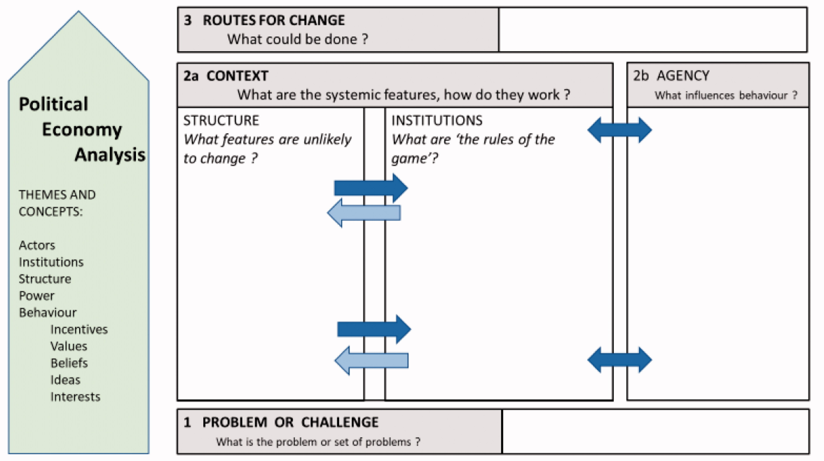
Analytical Framework: political economy viewpoint
No single definition of PEA or constructs
Structural, institutional, and agentic influences
Reflexive deliberation: dynamics, and interactions
Source: Andreas et al., 2022

Slide 6


Methodology
Data collection: ‘explicit’ & ‘tacit’ Knowledge
Document analysis
                Ministry of Health
                Ministry of Education
                Office of the Prime Minister
                National Child Development
                Agency
                Local government
                Community leaders
KIIs (n=10)
National Mental Health Policy
Health Sector Strategic Plan (HSSP IV & V
National Strategy for Transformation ( NST1 & NST2)
WHO Mental Health Atlas country profile for Rwanda

Slide 7
Findings
Structures
Institutions
Agency
Route for change
The 1994 genocide against the Tutsi as the foundational structural condition
“If a parent has an unhealed long-term scar related to our history, then they will pass it on to their children, and the children are also affected”. (Central Government Official)
Poverty constraining household care and institutional capacity
Cultural, gendered norms, stigma or moral framework, traditional and religious healing
Family as institutional setting — structural pressures translated into children’s mental health experiences.
“Children grow up in harsh situations at home, resulting in stress and other different problems - child abuse, including corporal punishment”… (Central Government Official)
Schools — recognized as promising sites for mental health support, but programmes remain limited in coverage, staffing, and referral capacity.
Health system — strong policy architecture and sectoral recognition, yet child/adolescent services remain limited, with workforce shortages and rural access barriers.
National planning architecture
CAMH is recognized within Rwanda’s health sector policies and strategies
Not yet fully embedded across national development frameworks
Let's say the time we were reviewing NST1… the national vision was focusing on enrolment, student performance, dropout cases… but there was silence when it came to mental health. (Central Government Official)
Local actors— committed to child and adolescent mental wellbeing, but implementation shaped by fiscal and governance arrangements
Children and families live the consequences with limited influence
Collaboration & prevention — stronger coordination across sectors and greater investment in family‑level and school‑based interventions
CAMH Strategy under development by MoH and UNICEF

Slide 8
Discussion
Rwanda shows strong sectoral commitment to mental health but weak cross‑government embedding.
Structural conditions generate high need while limiting Institutional capacity.
Families, schools, and health systems are overloaded, expected to absorb adversity without adequate resources.
Findings resonates with critiques of biomedical framing (Moncrieff, 2022): service expansion alone cannot address structural drivers.
Consistent with social determinants of mental health (Lund et al., 2018).
Implication
Schools & community structures are key platforms for CAMH, but current programmes remain limited; national expansion with stronger referral and family linkages is needed.
Cross‑sector embedding is essential
The analysis points to building on existing sectoral commitments.
The findings point to the urgency of sustainability.

Slide 9
Conclusion and Recommendations
Rwanda has a strong policy base for mental health, but child and adolescent mental health is unevenly embedded across planning levels.
PEA shows gaps arise from structural adversity and institutional constraints
Strengthening CAMH requires extending commitments into education, child protection, local government, and community systems.
Recommendations
Expand school and community platforms with referral and family support.
Embed CAMH into cross‑sector frameworks and monitored indicators.
Ensure sustainability through domestic financing.

Slide 10


Acknowledgement
Funding: The author(s) declare financial support was received for the research, authorship, and/or publication of this article. This research was funded by the National Institute for Health and Care Research (NIHR 133712) using UK aid from the UK Government to support global health research.
Disclaimer: The views expressed in this publication are those of the author(s) and not necessarily those of the NIHR or the UK government, the Court of the University of Aberdeen, the Board of Directors of the University of Rwanda, the Board of Directors of Addis Ababa University, or our International Advisory Board.
Copyright: This is an open-access PPT distributed under the terms of the Creative Commons Attribution License, which permits unrestricted use, distribution, and reproduction in any medium, provided the original author and source are credited.

