Slide 1


Developing and Delivering a School-based Mindfulness Intervention (SBMI) for Schools in
Sub-Saharan Africa
17th June 2026
Presented by Kaleeba Ali,
University of Rwanda, College of Education
As part of NIHR Global Health Research Group on Promoting Children's and Adolescent's Mental Wellbeing in sub-Saharan Africa
Contact: Cellphone +250788857085
Email : kaleebaa@gmail.com

Slide 2
Background
The concept of mindfulness originated from the religious tradition of Buddhism (Tilahun & Vezzuto, 2014). Present in many world religions
Mindfulness refers to the practice of paying attention on purpose to present-moment experiences without judgement and with kindness (Kabat-Zinn, 2003)
Over the decades, mindfulness has been adapted into secular programmes in education and health care. Most notably in health care settings (MBSR 1979 Jon Kabat Zinn). Leading to a lot of research on its therapeutic use.
There is a body of research stating benefits of mindfulness and improved wellbeing and also the benefit of its use in schools and education not just therapeutic.
Despite growing global interest in School Based Mindfulness Interventions (SBMI), limited evidence exists on how mindfulness programmes can be culturally adapted and delivered within Sub-Saharan African school contexts.

Slide 3
Rationale
Many adolescents in Rwanda experience psychological distress linked to poverty, family instability, adverse childhood experiences, and PTSD challenges(MoH, 2024)
Studies show that mental health issues such as stress, anxiety, and emotional distress undermine learners' wellbeing, school participation, concentration, and academic performance (NISR, 2024; WHO, 2021; Deng et al., 2022; Becker et al., 2025)
Existing mental health-related studies in Rwanda show that mental health initiatives have mainly focused on the general population (Kayiteshonga et al., 2022; Binagwaho & Senga, 2021; Mukantwali et al., 2024; Balthazar et al., 2021).
While schools are important settings for promoting learners’ wellbeing and mental health support, there are few, if any, initiatives on SBMI in Rwanda.

Slide 4
Part of the NIHR Project - Work Package Two –
Context Specific Intervention, Design and Delivery
Objective
To develop and deliver a culturally appropriate, whole school intervention to promote CA mental wellbeing, working with teachers, parents CA, community members and policy actors.
Team
Three UK & Ireland based ‘experts’ in Mindfulness (for Adults and Young People) representing the University of Aberdeen.
Rwandan Team - 2 co-investigators UR Education School and 2 teacher-training college educators (supported by Research Assistant and Community Representative)
Ethiopian Team - 2 co-investigators and 2 teacher-training college educators (supported by Research Assistant and Research Manager)

Slide 5
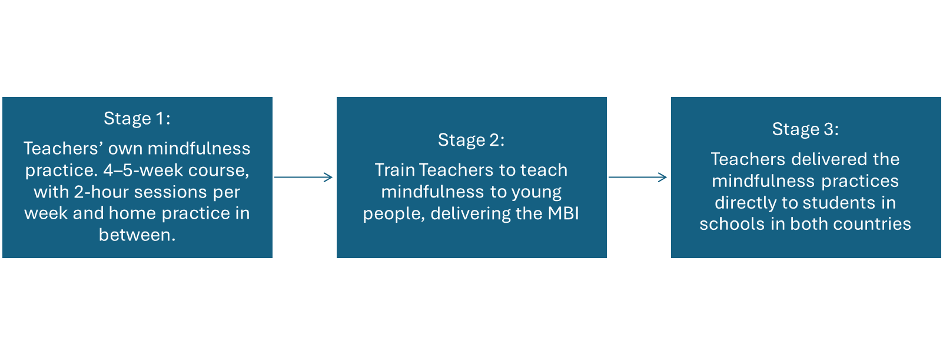
Capacity Building as a Foundation for Developing the Intervention
Developed by first building the capacity of teacher educators (Wrk Pk 2) and Mindfulness Champions (Teachers in Feasibility and Intervention School) in both urban (Ethiopia) and rural (Rwanda) regions.
A cascade approach adopted to build capacity in both:
Adult Mindfulness Focus – Our project follows the approach for teachers to teach mindfulness they must first practice
School and Youth Focus – The understanding that adult mindfulness is very different to youth and school settings.
Led to cascade approach to training and implementation
Notes:
A collaborative process which helped ensure that the intervention responded to the educational settings and the needs of children, adolescents and teachers in both countries.
The intervention was informed by both existing mindfulness approaches and newly developed project-specific elements.
The intervention thus emerged through a process of adaptation, contextual relevance, and innovation.

Slide 6
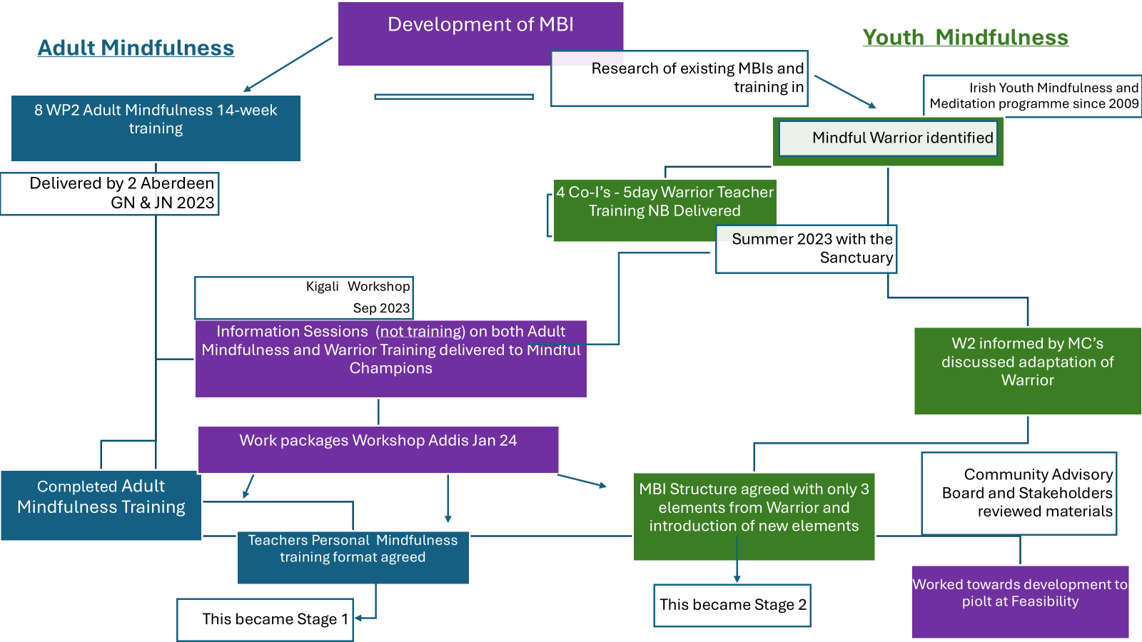
Notes:
The following graph shows ongoing development of the intervention using research led, best practice and existing programmes which were culturally developed and also informed by relevant stakeholders and reviewed by community advisory boards.

Slide 7
Consultation with local groups and stakeholders
For all work packages within the research project, Community Engagement was present. Consultation Groups and stakeholders at various points were consulted and asked to review research materials including the intervention materials. These included:
Community Advisory Board (12 members)
    Vice major in charge of social affairs
    DEO & SEO
    District council representative
    Youth Council representatives
    Sector representative
    Cell respresentative
    village representative
    Religious representative
    Community worker representative
    Inshuti z'Umuryango(Friends of Family)
    Parent representative

Slide 8
Also, the Project consulted:
Teachers
Reference Groups ( Parents and children )
MINEDUC (mental health well being specialist )
DEO
Rwanda National Ethics Committee
MoH (Rwanda Biomedical Centre officials)

Slide 9
Key Feedback from Stakeholder Consultations
Strong support for and acceptance of the intervention.
Piloting before implementation – Ali this was planned feasibility already part of the project did the stakeholder give something different?
Training of teachers - what is this feedback?
Alignment with the existing curriculum and school timetable.
Acceptance of the translated term “Turisha Umutima” as the local expression for mindfulness.

Slide 10
Key Considerations in the Development of the SBMI
The intervention was culturally adapted for Rwanda and Ethiopia.
It was designed for all students in the schools, including mixed abilities
A whole school approach but not ‘one size fits all’. Variety and choice embedded.
It was developed as a secular intervention to be used across different school settings.
The practices were designed to fit into existing school timetables with least disruption and suitable for large class sizes.
It required only limited materials and basic teacher training – Cost Effective.
It was also linked with Rwandan policies such as reforestation, peace education, Umuganda and school-based well-being support.
As a sub-Saharan project, it used the African philosophy of Ubuntu rather than Buddhist teachings.
Trauma informed mindfulness concepts and theory was adhered to.
Sensory foraging Research and Compassion are key elements and complimentary.
Discipline and Mindfulness

Slide 11
Piloting the SBMI and Revision of the intervention practice
The feasibility stage tested its practicality, clarity, suitability, and appropriate duration of each practice in real school settings.
It also helped assess the appropriateness of the materials and delivery approaches for learners.
Learnings
Flexible delivery in Kinyarwanda or English and translation of selected mindfulness practices.
Additional materials needed for teachers to understand the practices further.
Use of local instrumental drumming music for mindfulness activities.
Further development of Movement Practice (3 options) for variety and choice.
The reduced time of teacher's availability for training and the change needed for Stage 1
Design of a mindfulness implementation log to monitor intervention fidelity and implementation.
This refined intervention was then implemented in the intervention schools.

Slide 12
Capacity-Building Approach to Prepare teachers Classroom Delivery of SBMI
Stage 1: Teachers’ own mindfulness practice. 4–5-week course, with 2-hour sessions per week and home practice in between.
Stage 2: Train Teachers to teach mindfulness to young people, delivering the MBI
Stage 3: Teachers delivered the mindfulness practices directly to students in schools in both countries
Notes:
AS we saw earlier a cascade approach was taken to the development of the intervention and also is present in our training structure as seen on the table above. Stage 1 consists of a 5 week course of 1.5 hours duration. Stage 2 is a 5 day training (with future adaptation for a mix of online and face to face to facilitate flexibility and availability.) Stage 3 is during the delivery of the intervention where continuing development of practice through collaboration, personal Practice, Mindful Champions and self reporting tools are used leading to the encouragement of student led and peer practice.

Slide 13
Origin of the Intervention
Overview of the SBMI Practices
Frequency | Practice | Duration | Frequency | Who Leads | Materials | When Introduced
Daily | Hands on Desk HOD | 2-3 minutes | Daily beginning of every class | Every teachers to every class | Nothing classroom based | Right at the beginning and continues
 | Welcome Drums | 1st hour as arrive | Every morning | Through a speaker with welcome banner | Portable speaker & Banner | A week or 2 after introduction
Weekly | Mindful Movement | Range of 2 min to whole PE class | Movement in class or PE class | PE teacher any teacher can bring m breaks | None | 3/4th week continued
 | Breath Practice | 3-5 min | Once a week | All teachers to all | None | 3 weeks after start
 | Storytelling | 1st wk 10min then 20min | Once a week | Language | Stories in manual | Month into starting
Once a week over 3 or 4 classes | Tree Noticing | 5 min – 30 | At least 3 times | All students receive | pictures & paper | Second month
One off lessons | Mindful Planting | Whole class | One off lesson | Science or Geography | bulbs pots H2O | 1st month end
 | Mindful Eating | Whole class | One off lesson | Choice | Fruit | 2 month
The intervention was informed by both existing mindfulness approaches and newly developed project-specific elements.
It drew on practices previously used in youth and school contexts elsewhere, while adapting them to the cultural and educational realities of Rwanda and Ethiopia.
New elements were developed to respond to the specific contexts in both countries.
The intervention thus emerged through a process of adaptation, contextual relevance, and innovation.
Notes:
Although a whole school approach it is not a one size fits all programme. There was a cascade approach to the intervention with choice and variety throughout and encouraged. Practices introduced slowly in a building block format with a variety of durations of practices and lesson time and a mix of delivery formats from, all teachers to all students, down to certain subject teachers deliver to certain age range of students for certain elements. There was also additional materials and activities developed for teachers if they choose.

Slide 14
Ongoing Development
Ongoing evaluation and review during the delivery with the intervention school.
Adaptations made as needed and support and reflections continued.
Midline reports and observation visits by teacher educators and University of Aberdeen member, took place.
Teachers and students helped inform development also.
These were fed into the materials and development of the training for the control school, where we used the original training team with both UR and Aberdeen, but also supported by Mindful Champions from Feasibility and Intervention School.
School District and Wellbeing Lead with Rwandan Government attended Control Training. – Ali get Elaines proper title,
Key materials adapted and available for future growth along with and suggested future pathways.

Slide 15
Conclusion
The Project showed that with collaborative work and ongoing consultation using international expertise and best practice, national university staff, regional teacher educators and local knowledge; a culturally appropriate intervention using mindfulness is possible in Rwanda.
At present data is being analysed by our colleagues, but many promising evidence is already showing.
Our hope is, with evidence showing benefit, that this work is continued throughout schools in Rwanda with the project leaving behind a library of materials with a suggested pathway to do so and local knowledge.

Slide 16


Slide 17
Acknowledgments
This research was funded by the NIHR (NIHR133712) using UK international development funding from the UK Government to support global health research. The views expressed in this publication are those of the author(s) and not necessarily those of the NIHR or the UK government, the Court of the University of Aberdeen, the Board of Directors of the University of Rwanda, the Board of Directors of Addis Ababa University or our International Advisory Board.
Copyright © 2024 University of Aberdeen. For the purpose of open access, the author(s) has applied a CC BY public copyright license.

