Slide 1
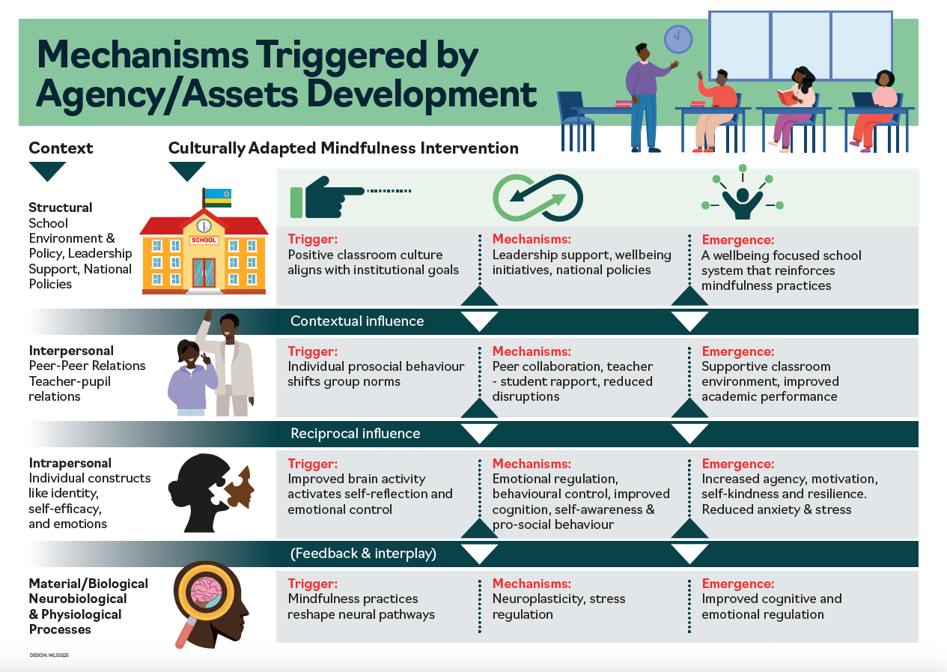


Developing transdisciplinary theory:
How does mindfulness work in schools in Ethiopia and Rwanda?
Step 5: Transdisciplinary theory
Step 1: Build framework (programme theory)
Step 2: Identify disciplines
Step 3: Review evidence
Step 4: Integrate insights
Step 2: Disciplines identified
using ‘laminated system’
Biological/intrapersonal
Biology/physiology
Psychology
Interpersonal
Education
Sociology
Macro
Sociology
Public health
Politics
Economics
Step 1: 5 explanatory models
Archer’s morphogenic approach
Bonell et al.’s school climate /health
Pearlin’s social causes of depression
Booker’s emergent psychological mechanisms
Review of SR’s of SBMIs
Step 3: Review used CR tool
ICAMO tool (Archer): Intervention-Context-Agency-Mechanism-Outcome
How interventions work in context
Step 4: Synthesis
Integrated insights from disciplines
Interpreted findings develop plausible explanations
Produced by Pamela Abbott and Lucia D’Ambruoso
NIHR Global Health Research Group on promoting children's and adolescent's mental wellbeing in sub-Saharan Africa (NIHR133712)

