Slide 1
‘Grave Goods’
What objects do we give people when they die – and why?
Dr Jennie Riley – University of Aberdeen

Slide 2
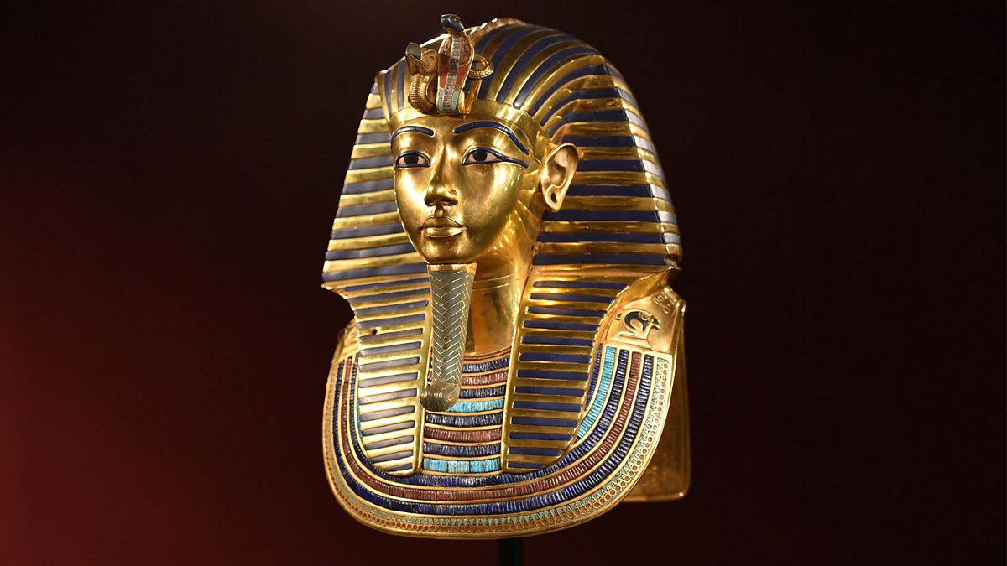
Death mask of Pharaoh Tutankhamun
Notes:
BBC Radio 4 - https://www.google.com/url?sa=i&url=https%3A%2F%2Fwww.bbc.co.uk%2Fprogrammes%2Fm000cng6&psig=AOvVaw1j-nSc1K8celVUV7T57Zgs&ust=1752048137416000&source=images&cd=vfe&opi=89978449&ved=0CBYQjRxqFwoTCLiv_IjmrI4DFQAAAAAdAAAAABAE

Slide 3
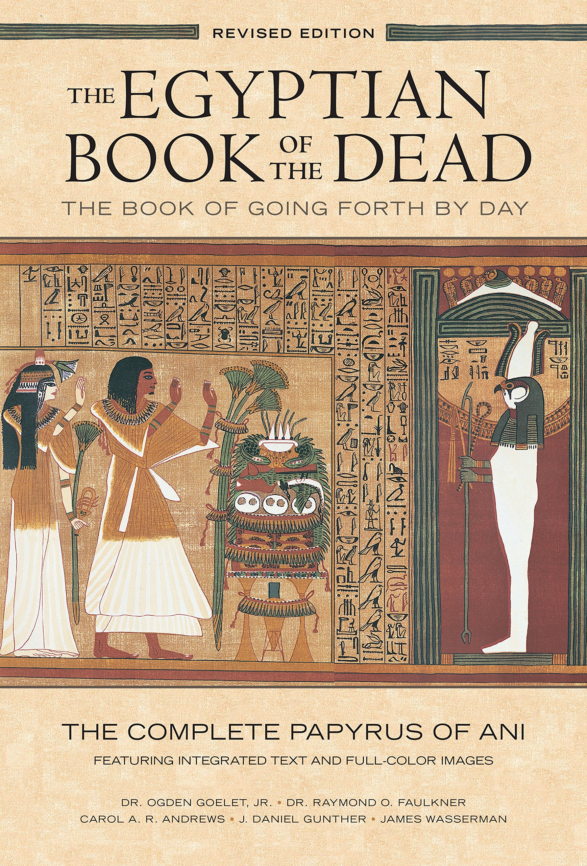
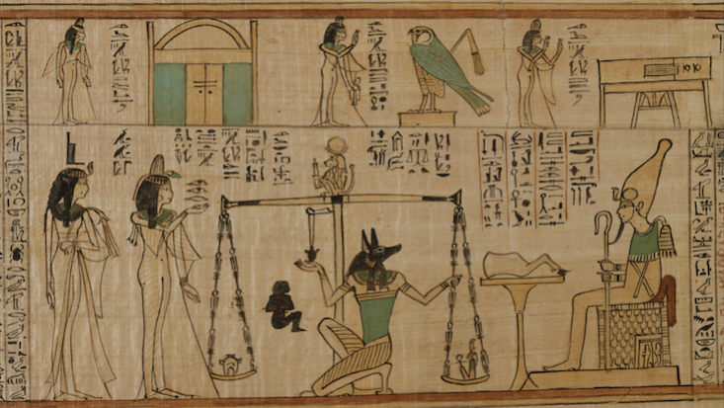
The Egyptian Book of the Dead

Slide 4
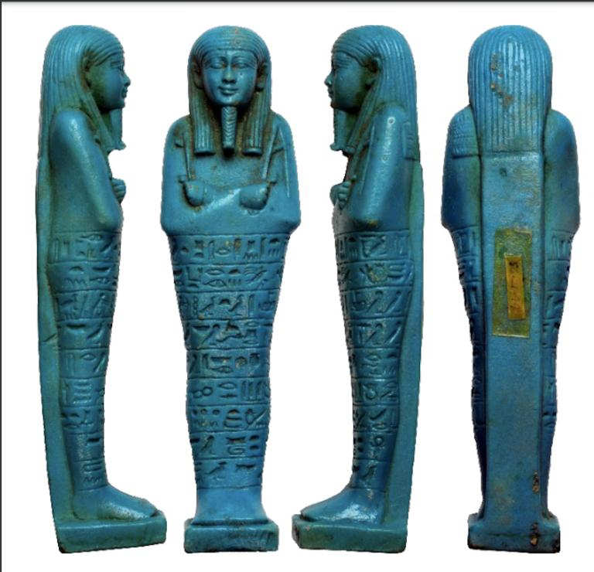
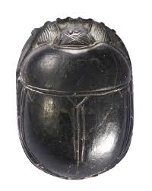
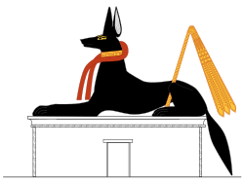
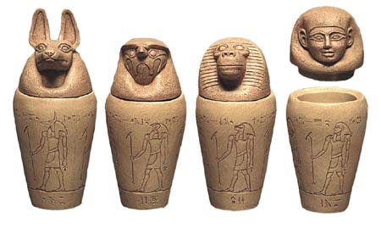
Examples of Ancient Egyptian grave goods
Notes:
Shabti: https://images.liverpoolmuseums.org.uk/styles/dynamic_medium/public/import-objects/195487_v0_large.jpg
Heart Scarab - https://www.mfab.hu/app/uploads/2018/10/25660.jpg
Anubis - https://upload.wikimedia.org/wikipedia/commons/thumb/f/f7/Anubis_jackal.svg/250px-Anubis_jackal.svg.png
Canopic jars - https://museumofmythology.com/Egypt/canoptic%20jars/canoptic%20jars/canoptic%20jars-1.jpg

Slide 5
Can you match the religion to the grave goods they might use when people die?
ISLAM
CHRISTIANITY
HINDUISM
JUDAISM
SIKHISM
BUDDHISM
ROSARY
STEEL BRACELET
PRAYER SHAWL
BRIGHT FLOWERS
NOTHING (JUST A SHROUD)
EARTH OR SOIL

Slide 6
Answers: match the grave goods to the religious group that might use them
ISLAM
CHRISTIANITY
HINDUISM
JUDAISM
SIKHISM
BUDDHISM
ROSARY
STEEL BRACELET
PRAYER SHAWL
BRIGHT FLOWERS
NOTHING (JUST A SHROUD)
EARTH OR SOIL

Slide 7
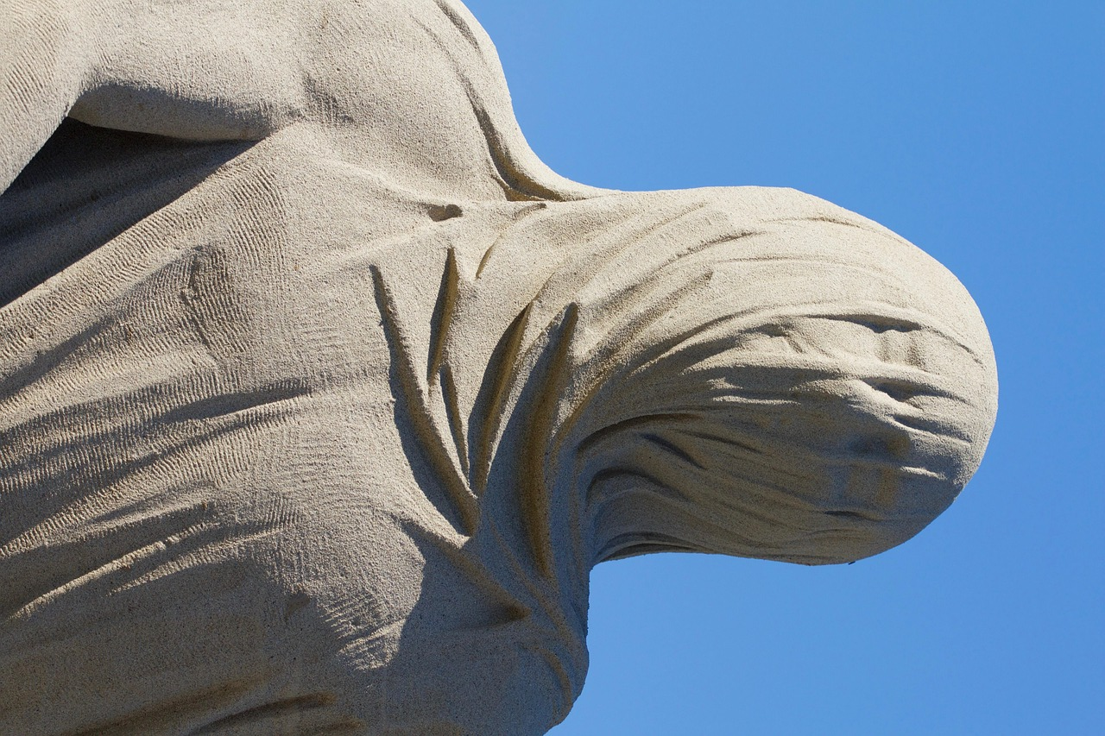
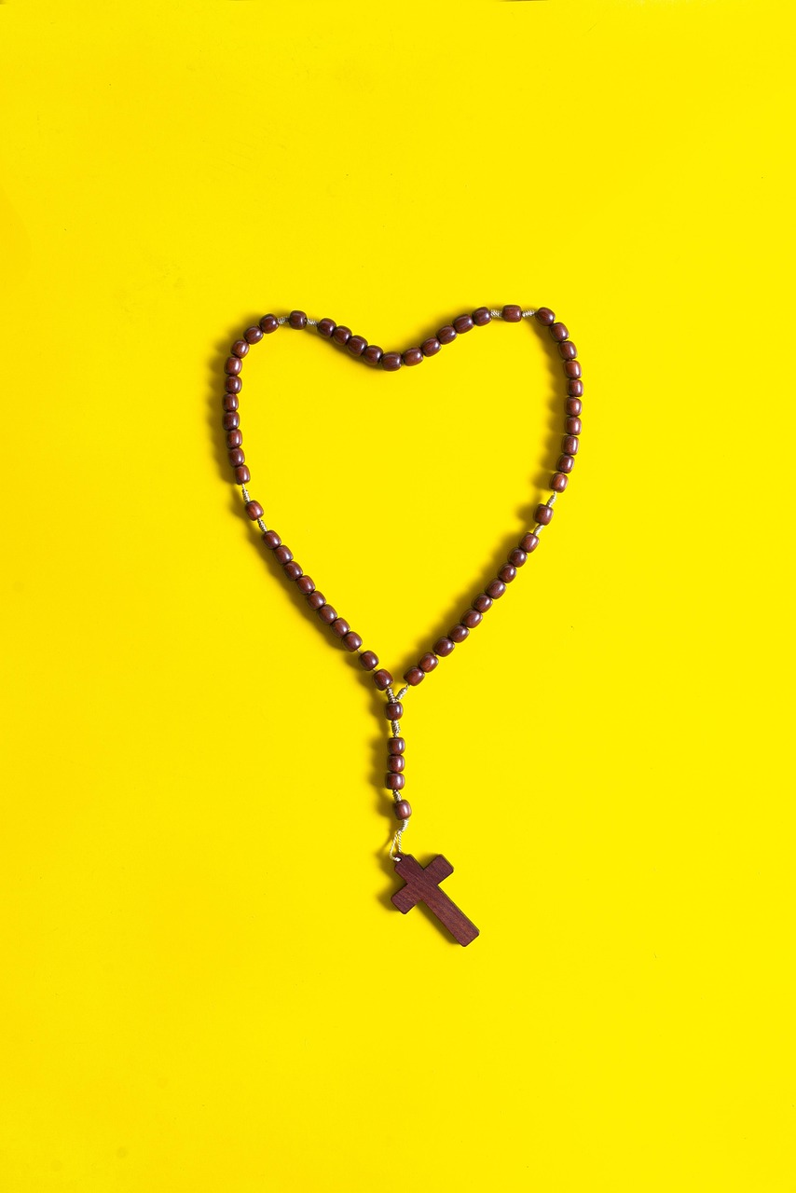
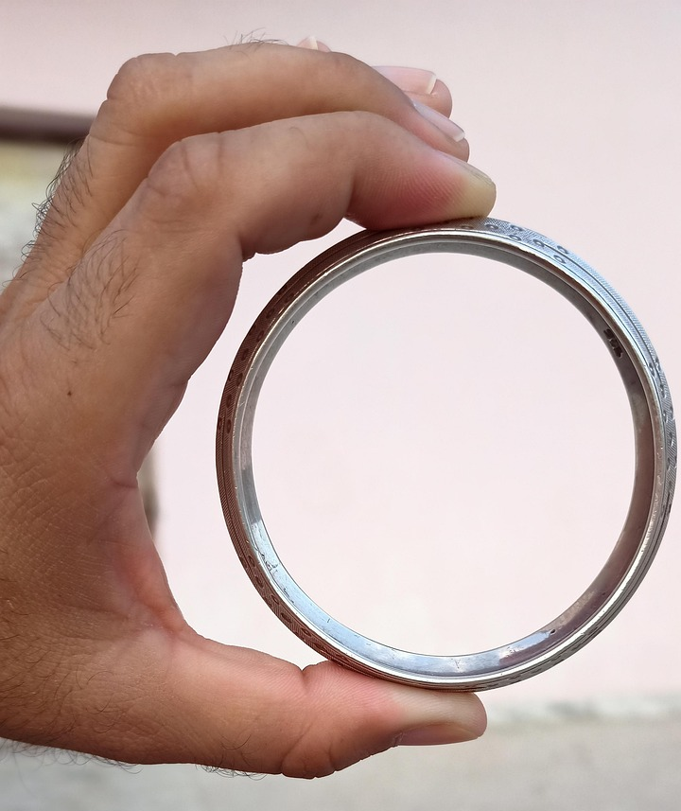
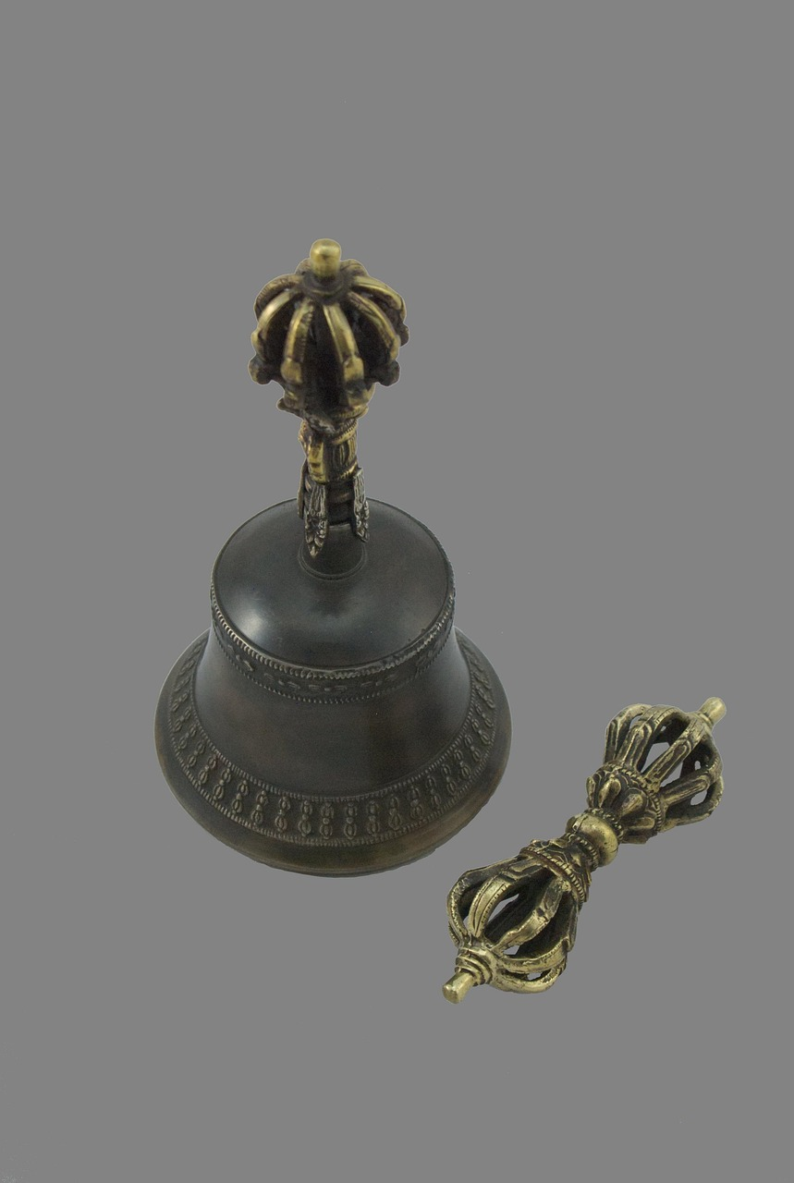
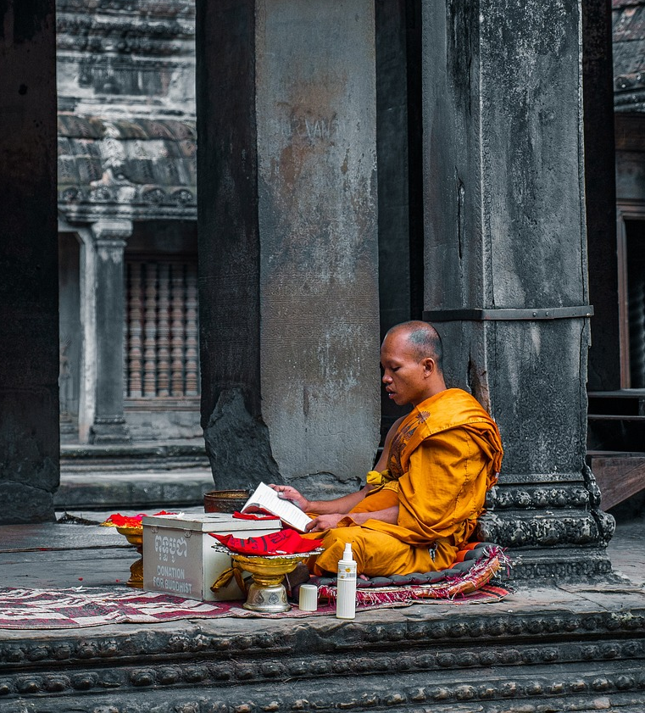
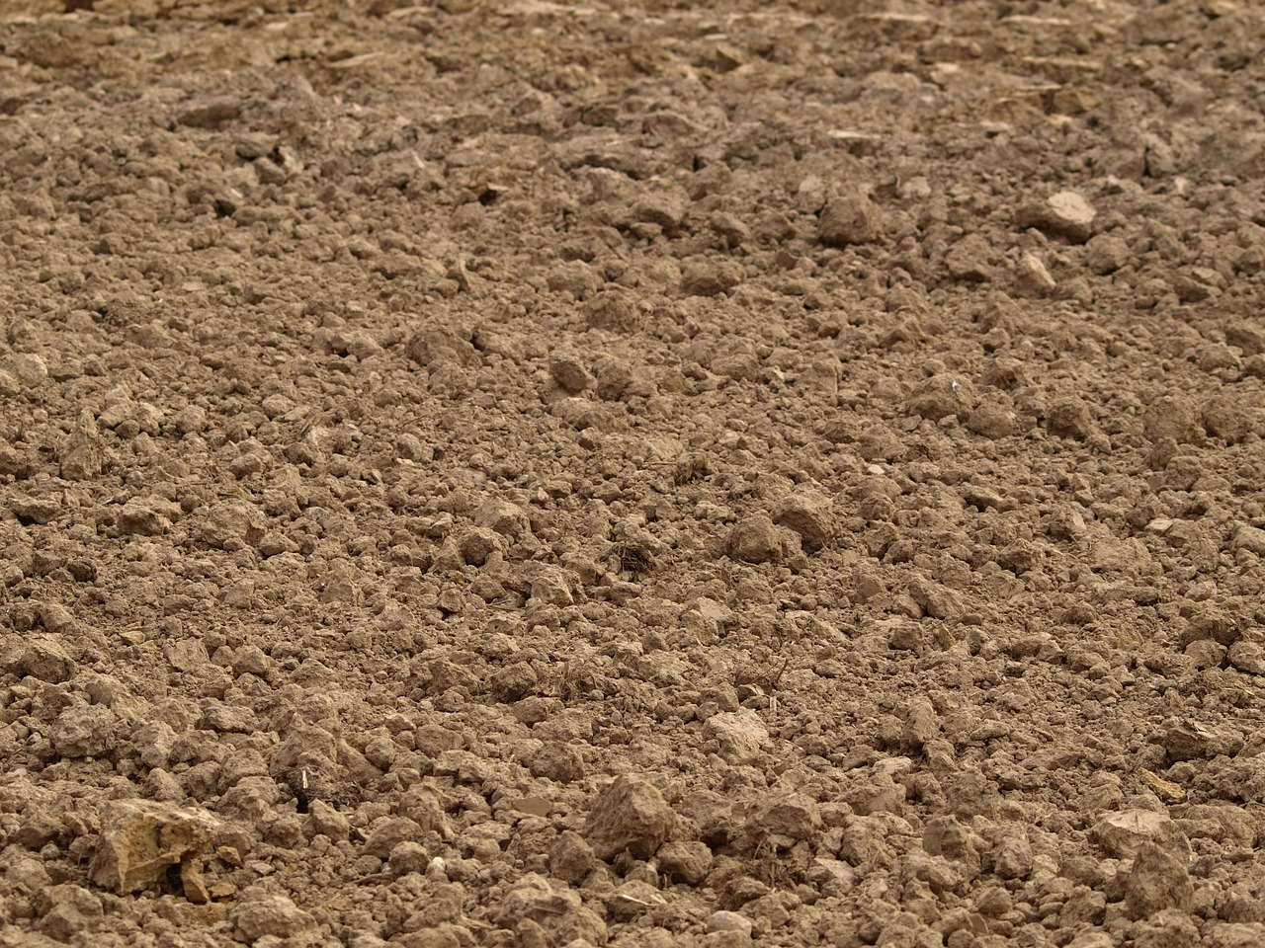
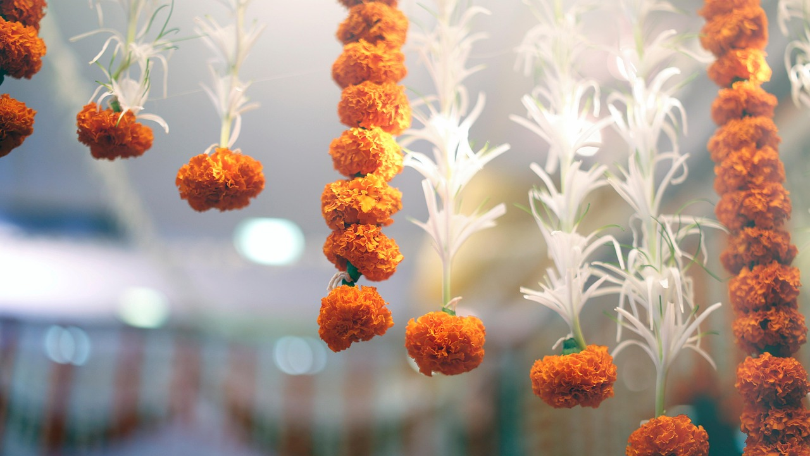
Images of common religious grave goods
Notes:
Rosary image: https://pixabay.com/photos/third-rosary-catholicism-jesus-2640997/
Soil: https://pixabay.com/photos/earth-soil-fields-field-312794/
Shroud: https://pixabay.com/photos/cloth-head-shroud-sand-sculpture-1618371/
Bangle: https://pixabay.com/photos/sikhism-steel-kada-iron-bracelet-6578438/
Flowers: https://pixabay.com/photos/flowers-petals-floral-hindu-5628058/
Vajra and dorje (bell) - https://pixabay.com/photos/vajra-and-dorje-tantra-buddhism-3773432/
Buddhist robes - https://pixabay.com/photos/monk-temple-meditation-buddha-4649046/

Slide 8
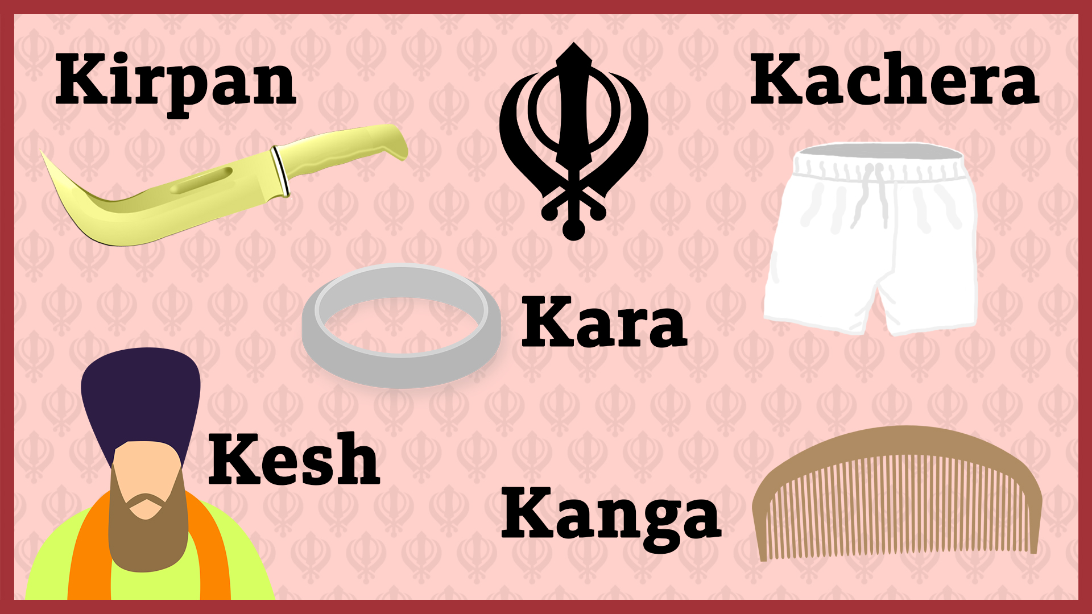
“Five Ks” - Sikhism
Notes:
Kesh: Uncut hair, symbolizing respect for God's creation and acceptance of God's will.
Kangha: A small wooden comb, signifying cleanliness and discipline.
Kara: A steel or iron bracelet, symbolizing God's eternity and connection to the divine.
Kachera: Special cotton undershorts, representing moral restraint and self-control.
Kirpan: A short sword, symbolizing the duty to defend the weak and uphold justice.

Slide 9
Religion in England and Wales (in 2021)
Religion | % of population
Christian | 46.2
No religion | 37.2
Muslim | 6.5
Hindu | 1.7
Sikh | 0.9
Other religion | 0.6
Buddhist | 0.5
Jewish | 0.5
Not stated | 6

Slide 10
Religion in Scotland (in 2022)
Religion | % of population
No Religion | 51.1
Christian | 38.8
Not stated | 6.2
Muslim | 2.2
Hindu | 0.6
Pagan | 0.4
Buddhist | 0.3
Other religion | 0.2
Sikh | 0.2
Jewish | 0.1

Slide 11
Top Five Most Common Grave Goods (UK)
Flowers
Clothing
Photographs
Letters
Jewellery, watches and other accessories

Slide 12






















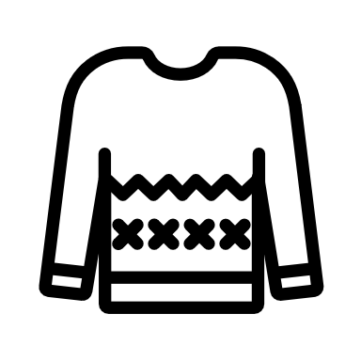

















The variety of things that might be picked as grave goods

Slide 13
Hover over the icons to learn more about each common grave good
Notes:
‘Hover’ animation tutorial: https://www.google.com/search?q=hover+animation+ppt&rlz=1C1GCEB_enGB972GB972&oq=hover+animation+ppt&gs_lcrp=EgZjaHJvbWUyBggAEEUYOTINCAEQABiGAxiABBiKBTIKCAIQABiABBiiBDIHCAMQABjvBdIBCDMwNjBqMGo3qAIAsAIA&sourceid=chrome&ie=UTF-8#fpstate=ive&vld=cid:c8ef1347,vid:epdAKPIULeA,st:0

Slide 14
FLOWERS
Some people pick out favourite flowers, or flowers grown by the person who has died.
Flowers are beautiful, and can also symbolise the cycle of life and death.
They are also natural, so will biodegrade without hurting the environment.

Slide 15
GLASSES
To make sure they look like themselves, people who wear glasses often also wear them when they have died.
Like special watches or jewellery, they might have been something very familiar, that the person wore every day.

Slide 16
MOBILE PHONES
Our mobile phones connect us to each other in life, and some people want to keep that connection in death.
We take them with us everywhere, so some people also want to take them with them when they die.
Our phones also often contain our photographs.

Slide 17
MEDICINES
Sometimes medicines are included as grave goods – things that helped people to feel better when they were alive.
They might represent those who are living wanting to take care of the person who has died, helping them to stay well.

Slide 18
HOBBIES
The things we like to do are important parts of our identities.
Sometimes grave goods reflect those hobbies – whether sports, reading, puzzles or knitting!
It’s good to have something you enjoy to keep you busy!

Slide 19
TOYS
Toys bring us comfort. We often keep them close and love them very much.
They feel familiar and safe, which can be important when death feels scary and unknown.
They are especially important when it is a child who has died.

Slide 20
CLOTHES
We express our identity and personalities through what we wear.
The dead are very often dressed in their own clothes – whether their best, smart clothes, or something cosy like their pyjamas.
Their relatives often choose this clothing for the person who has died – but some people choose their own.

Slide 21
LETTERS
Letters help us communicate special messages to other people, including those who have died.
Sometimes, last messages – containing memories, ‘thank yous’ or even apologies – are written and placed with those who have died.
Usually, they are not read by anybody else.

Slide 22
PHOTOS AND PICTURES
It is quite common to leave photographs and other pictures with someone who has died.
They are often pictures of the person who has died with people they love, or somewhere they liked to go.
They represent their relationships as well as people and places that brought them comfort and joy.

Slide 23
FOOD
Grave goods can include food and drink.
They’re often someone’s favourite things to eat – something they always enjoyed, or maybe saw as a treat or indulgence.
People want to make sure the dead have things they really like to enjoy.

Slide 24
Why do people pick these grave goods? There are lots of reasons!

Slide 25
Why do people pick these grave goods?
“It’s part of him, it’s got to go with him”
“You want to envelop them in an eternal hug”
“It felt right”
“It was her favourite”
“Nothing, as it’s completely pointless”
“It symbolises my love”
“To look after them”
“It helps to know that they’re connected”
“The whole point is that it’s something personal”
“I don’t know!”
“Things that you wanted to give them when they were alive, you don’t stop wanting to give them to them”
“I wanted him to have something that would remind him of me”
“In case he felt lonely”
“It would have made her smile”

Slide 26
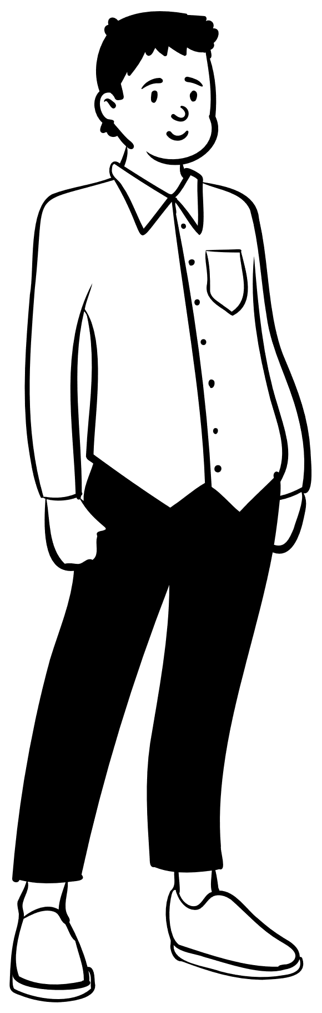


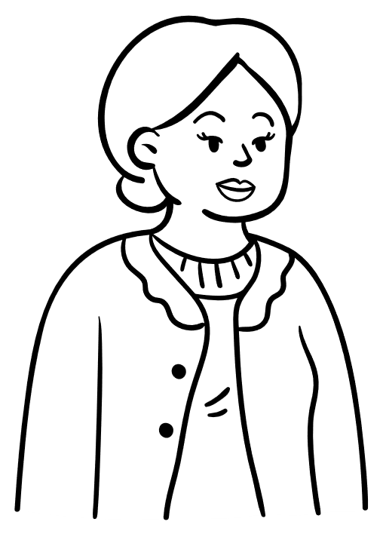



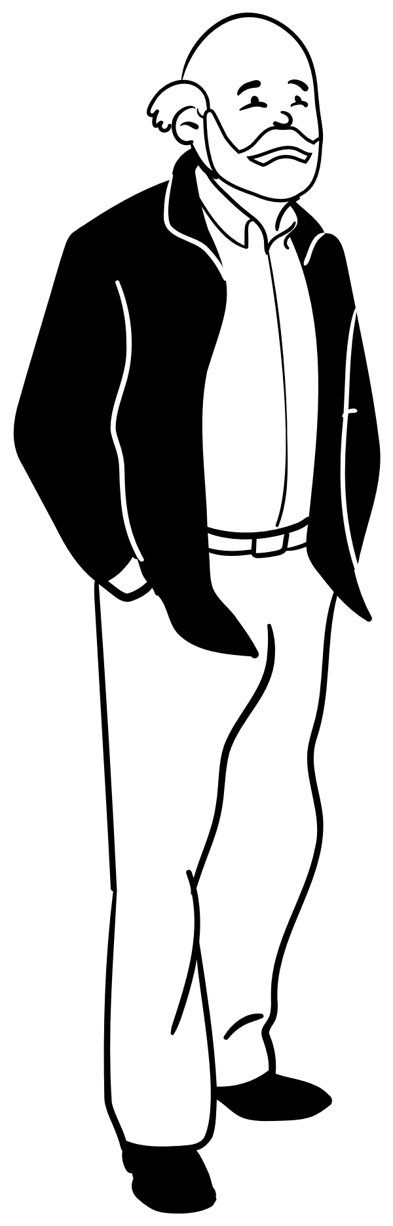
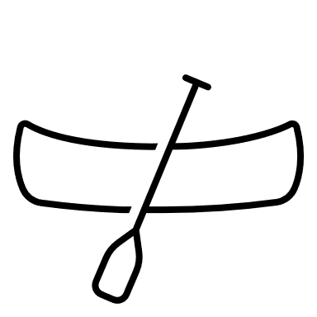

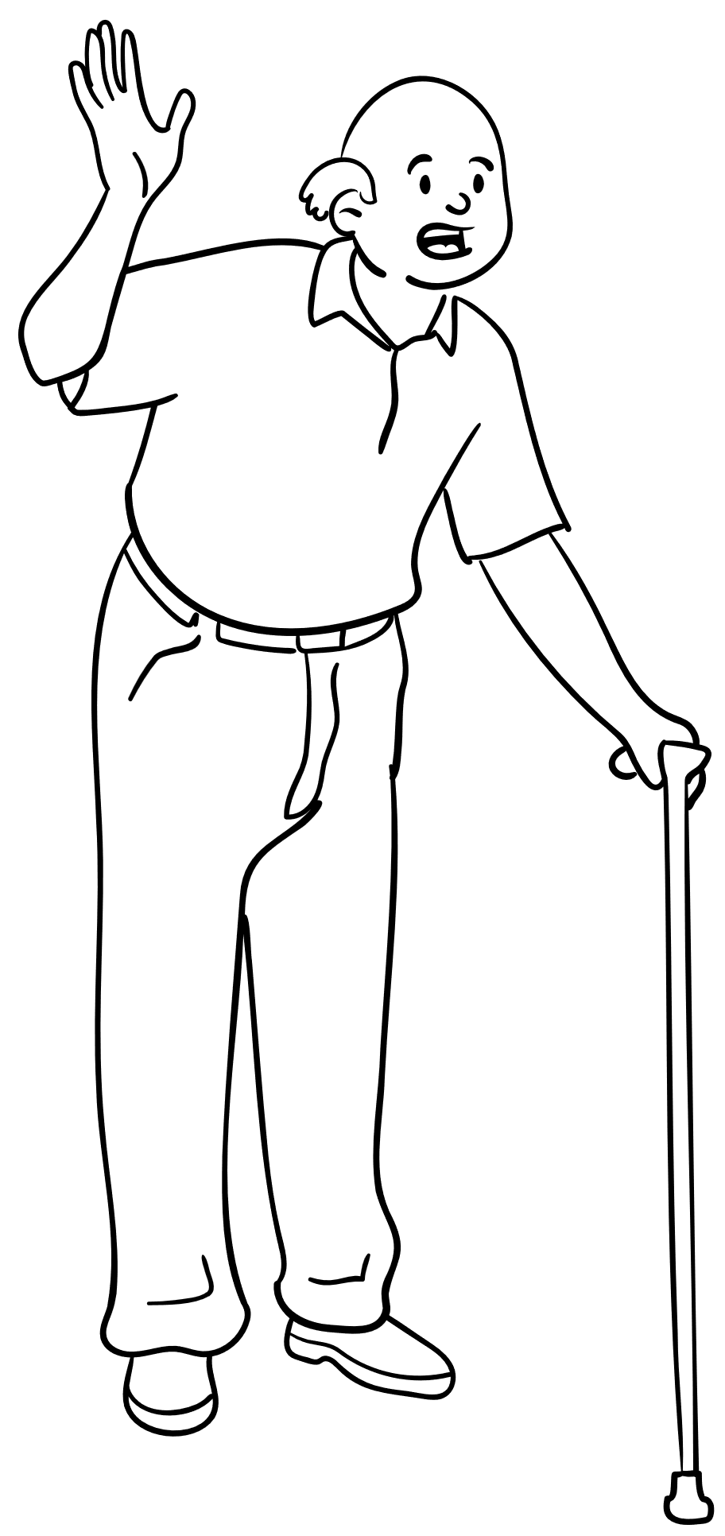
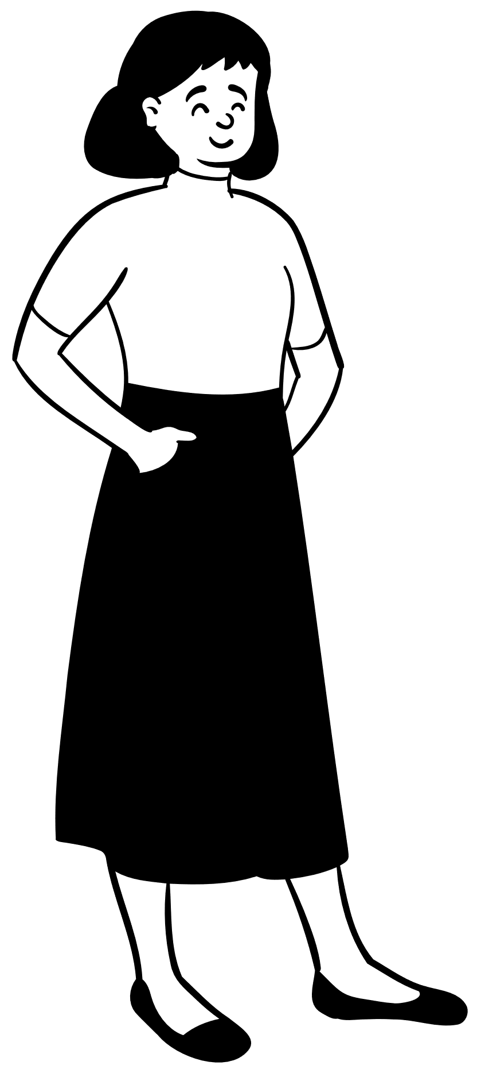






John’s Story
This is John!

Slide 27
What should we put in John’s coffin?
Draw what would you put in John’s coffin - and explain why!
Here are some things it might be helpful to think about:
Which objects might reflect John’s interests and identity?
What would John have liked? What did he enjoy doing?
Some things do not decompose, or might harm the environment. Does this affect your decision?
Might it be better to pass some of John’s belongings on to his family?
Grave goods are hard to get back – what if Jane changes her mind?
Are these items too valuable to bury? Is there a difference between financial value and sentimental value?
What will bring Jane comfort?
Does it matter?
If John is dead, what’s the point?!

Slide 28
This is John!

