Slide 1
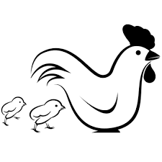
Why should farmed animal welfare matter to Christians in the 21st Century?

Slide 2
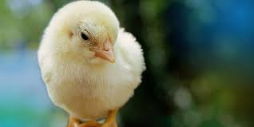
Learning Objectives
To understand Biblical views on the role of animals in creation.
To examine and evaluate the importance of flourishing for humans and other animals.
To begin to reach a judgement on the moral value of meat-eating and if this can promote flourishing.

Slide 3
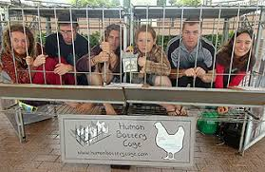
Starter
What is your reaction to this image?
Why might human beings protest being kept in cages?
Notes:
Hopefully this will spark some fruitful discussion. Try to guide students towards the inability of humans to FLOURISH in such conditions.

Slide 4
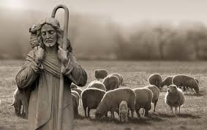
What does the bible say about the role of other animals?
Christians still turn to the Bible as a source of moral guidance. Other animals feature throughout the Bible and often help Christians to understand God’s purpose for Creation.
Turn to the handout to find out how this relationship between humans and other animals has been illustrated in the Bible.
EXTENSION: Can you find out which animal was used by Christians as a secret ID when they faced persecution after the death of Jesus? Bonus points if you can find out why they used this particular animal!
In the Genesis extract, it mentions that humans ought to RULE over other animals. What does it mean to rule over others?
Notes:
Extension Answer: A fish. This is because the Greek for fish, ‘icthys’, was used as an acronym for ‘Jesus Christ, Son of God and Savour’.

Slide 5
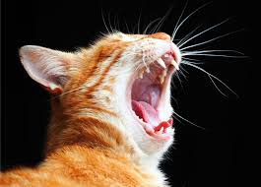
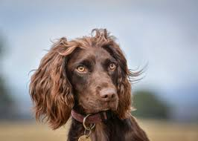
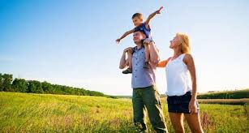
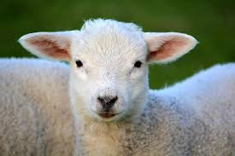
Flourishing
Chat with a friend, what does ‘flourishing’ mean?
What do you think you need to flourish?
What about any pets that you have/would like to have? What do they need to flourish?
Now consider your favourite farm animal, what do they need to flourish?

Slide 6
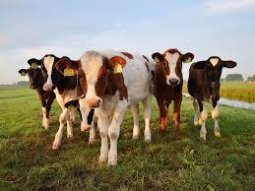
Why is flourishing important for Christians?
Some Christians believe that humans and animals are able to praise God by flourishing.
This means that they use the gifts given to them by God.
Humans could do this through prayers and good actions.
Other animals do this by doing what comes naturally to them. For farmed animals that could be grazing, caring for their young, rooting and having positive relationships.
How could famers and communities best support the flourishing of farmed animals? In groups, imagine you are members of a small village. What could the farmer, shopkeepers and shoppers in the village do to help farmed animals flourish?

Slide 7
The Bible & Eating Meat
One of the big questions that we will be looking at over the next few lessons is whether Christians should eat meat or not.
Two important stories in the Old Testament have led to debate over whether humans should eat meat.
Genesis 1
On the Sixth Day of Creation, God says to the humans he has created: “I give you every seed-bearing plant on the face of the whole earth and every tree that has fruit with seed in it. They will be yours for food. And to all the beasts of the earth and all the birds in the sky and all the creatures that move along the ground—everything that has the breath of life in it—I give every green plant for food.”
Genesis 6-9
God sent a great flood to wash away evil in the world, Noah saves his family and two of every living creature in a gigantic ark. God then issues a decree: “Everything that lives and moves about will be food for you. Just as I gave you the green plants, I now give you everything.
“But you must not eat meat that has its lifeblood still in it. And for your lifeblood I will surely demand an accounting. I will demand an accounting from every animal. ”
What is being commanded in each story?
Why might some Christians think that Genesis 1 is right?
Why is there an exception in Genesis 6? How might that guide how Christians look after farmed animals?
PLENARY: What do you think? Is eating meat acceptable?

