Slide 1
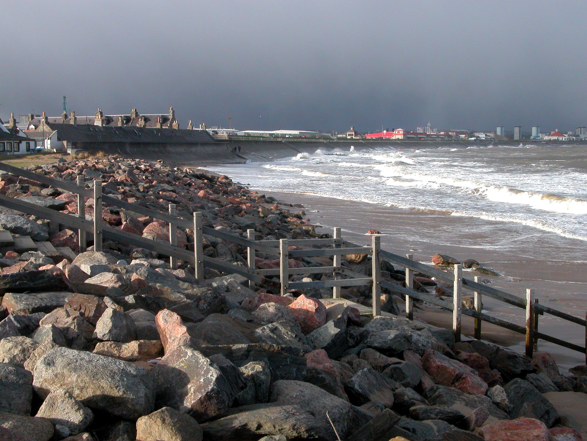
Aberdeen Institute of Coastal Science & Management
Professor William Ritchie & David R. Green

Slide 2
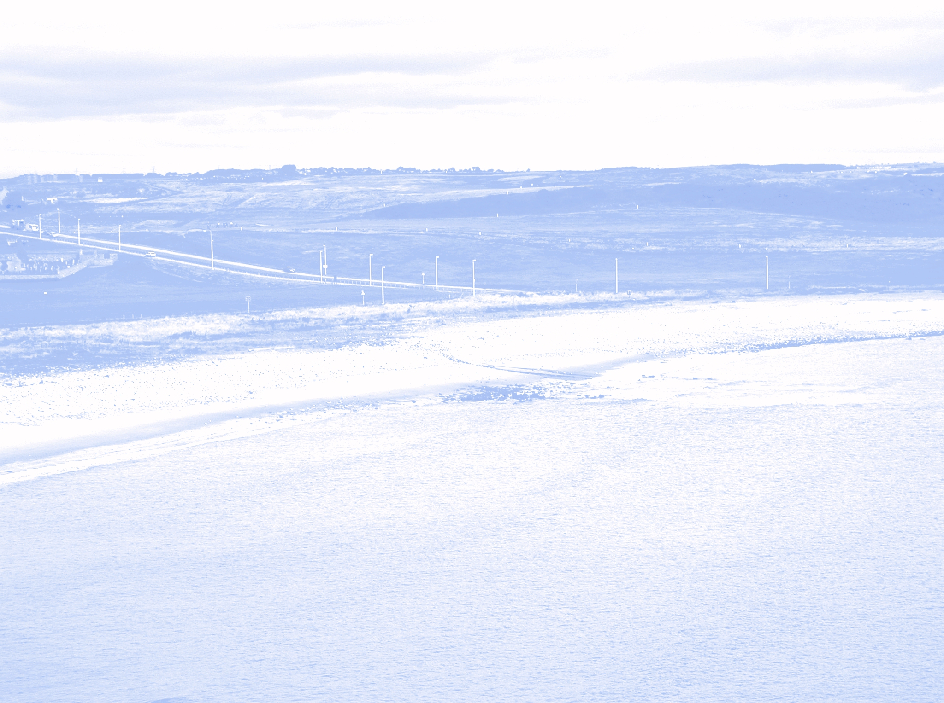
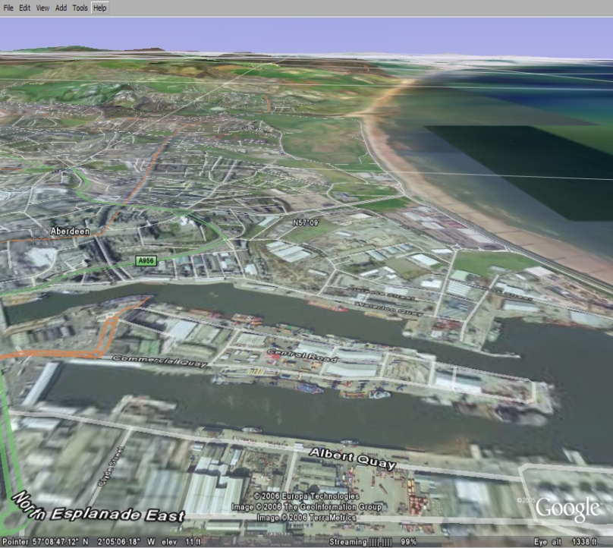
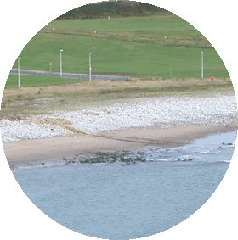
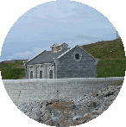
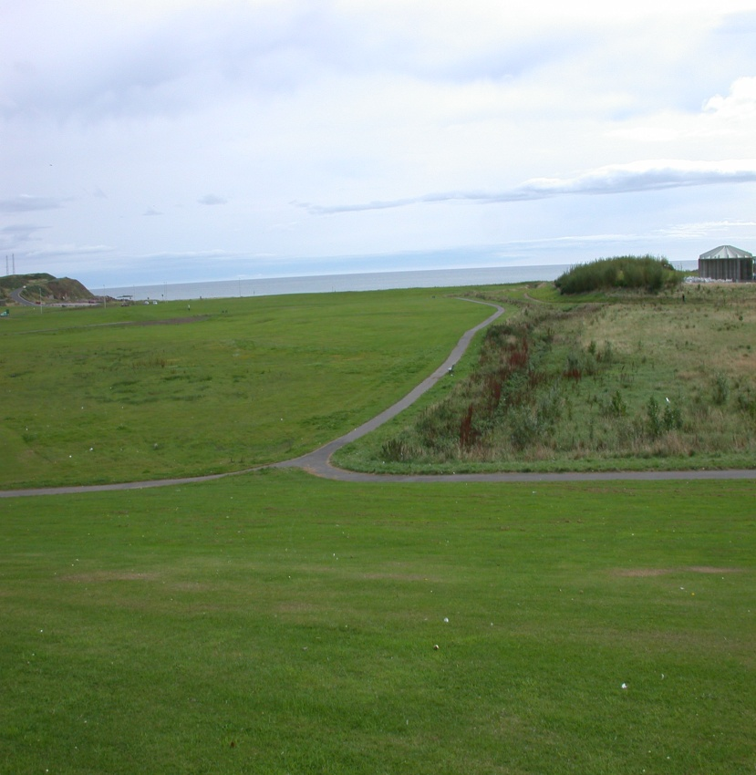
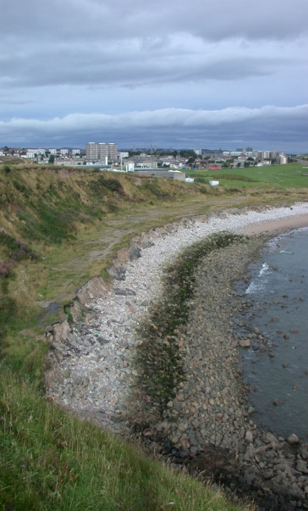
Data
GIS
Aberdeen City
Council
6
Sustainable
Landscape
& Communities
2
Local
Information
System
GIS
TORRY
REGENERATION
PROJECT
1
Inventory
Geography
Geology
Environment
Wave Climate
Historical
Cultural
Other
Public Access
Coastal Park
Coastal/Marine Resource Centre
Activities e.g. sailing (marina), diving (artificial reef), walking
Coastal Heritage
Historical Heritage
Coastal Footpaths
Tourism
Coastal Atlas
5
VR/GIS/ User Conflict Mapping
COREPOINT
Demonstrator
7
IMCORE
3
4
Resource
DRG - 2008 - University of Aberdeen

