Slide 1
Workshop
Academic Promotion –
How to write a successful application
March 2023

Slide 2
What we will cover today
General guidance:
(i) preparing to complete an application for academic promotion
(ii) before you start drafting your application
The application form – guidance by section

Slide 3
Preparing to complete your application
Start thinking about your promotion application early – soon after been appointed or promoted. Opportunity for clearer focus on the type of activities you need to engage in.
Start drafting application well in advance of the submission deadline to allow you to continue to improve it, including in the light of feedback.
Catch up/annual review meeting – discuss career aspirations with your line manager. Consider the Framework of Criteria and how your activities/outputs/experience stack up against the supporting indicators. Updates to Annual Review documents.

Slide 4
Preparing to complete your application
2023 round – you may not have had an annual review in the last 12 months but please discuss with ALM/Director/Head of School.
Create a ‘good evidence’ file of your professional achievements. E.g., information about nominations for awards, your work being cited by others, good feedback from students/colleagues.
Talk to other academics who have applied for promotion – learn from their experience. Ask if they are willing to share a copy of their application.

Slide 5
Before you start to draft your application
Discuss with your ALM or Head of School.
Review the Framework of Criteria and determine:
What Pillars are mandatory for the level of promotion you are seeking (N.B. Citizenship is mandatory)?
What optional areas if any do you plan to provide evidence under?
What are the suggested supporting indicators for the Pillars/level you are considering – remember these are just examples – there may be others, and you do not have to provide evidence of every one.

Slide 6
Completing your application
Line up a friendly reader to review your application before you submit it to your Head of School.
Remember that successful applications are those that make a case for promotion.
This means evidencing that what you have done has made a difference.
Your application should embed this evidence in a general career narrative.

Slide 7
Completing your application
Avoid summaries of ‘I have done this, and this, and this’ without evidence of impact.
Consider how you want to split the word count across the Pillars – based on the extent of evidence you have to provide in different areas.
Consider your audience. Contextualise your evidence/build in some field benchmarks.
Avoid the use of acronyms without explaining what they mean

Slide 8
Completing the application form

Slide 9
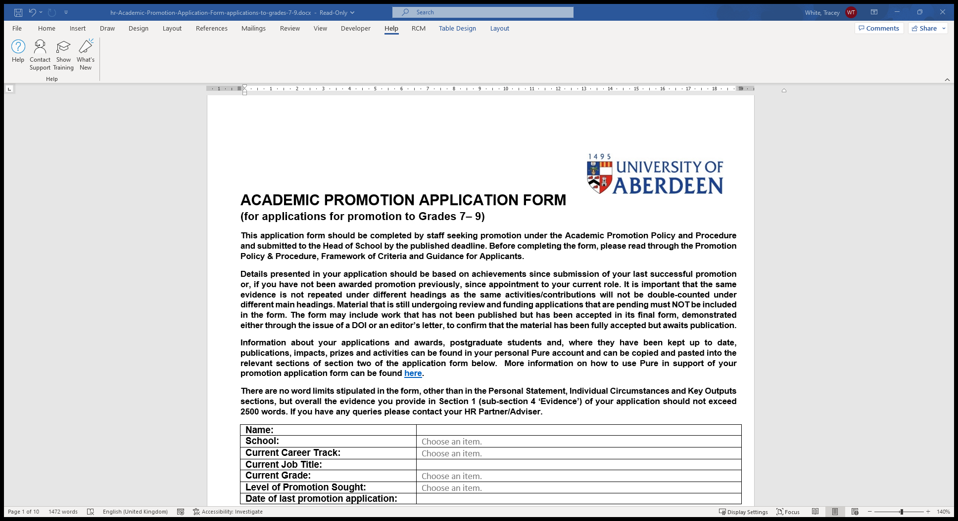
Note the word limits for some sections
Don’t repeat the same evidence under different sections
You can include work that has not been published but has been accepted in final form

Slide 10
Indicate which Pillars you will provide evidence under
Remember all applications must provide evidence under Citizenship – including contribution to equality, diversity and inclusion
Choices in accordance with minimum thresholds and possible combinations
You can include information under other Pillars if you wish to

Slide 11
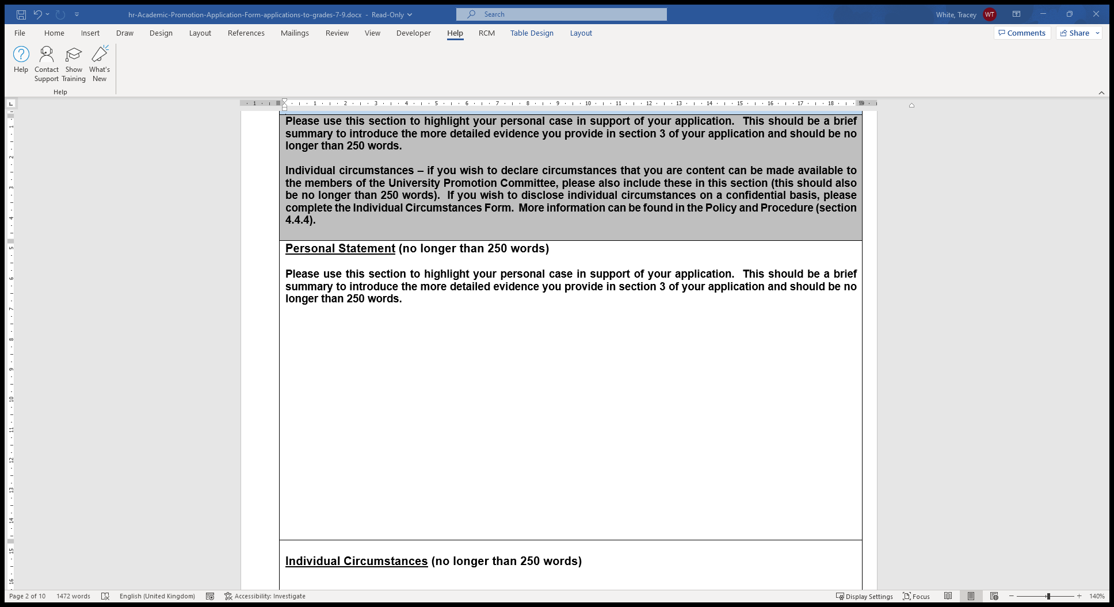
Personal statement – use this as an opportunity to create a sense of anticipation about what else you will be providing as your evidence
Note the word limits for each section – 250 words here
Individual circumstances – highlight anything that has impacted on quantity, not quality, of outputs. Option to complete separate form

Slide 12
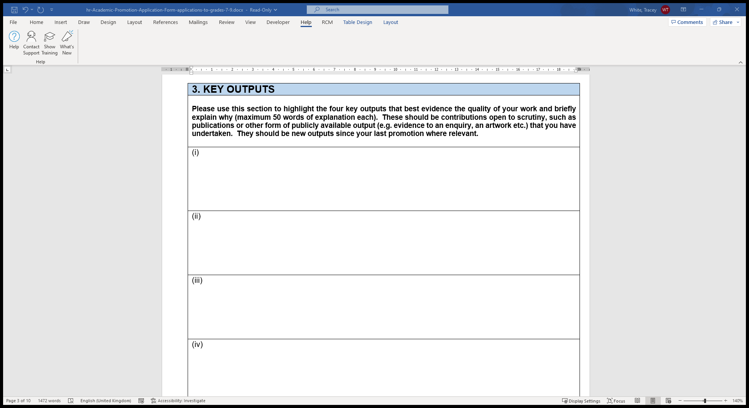
Highlight your 4 key outputs that best evidence the quality of your work/the impact your work has had since your last promotion if appropriate. Briefly explain why.
Depending on career track outputs could be related to Research; Education; Scholarship/ Professional Practice; Engagement, Innovation and Impact; Clinical Service
Note the word limits for each output – 50 words

Slide 13
In the Evidence section you should provide the detailed information under the appropriate Pillar which outlines your case for promotion.
Note the word limit of 2500 across all the areas in the evidence section
Show evidence of your work making a difference
In preparing your evidence refer to the criteria for each section – remember the supporting indicators are examples. There may be others and you do not have to provide evidence of all listed
Contextualise your information – provide benchmark information
Avoid the use of, or explain, acronyms

Slide 14
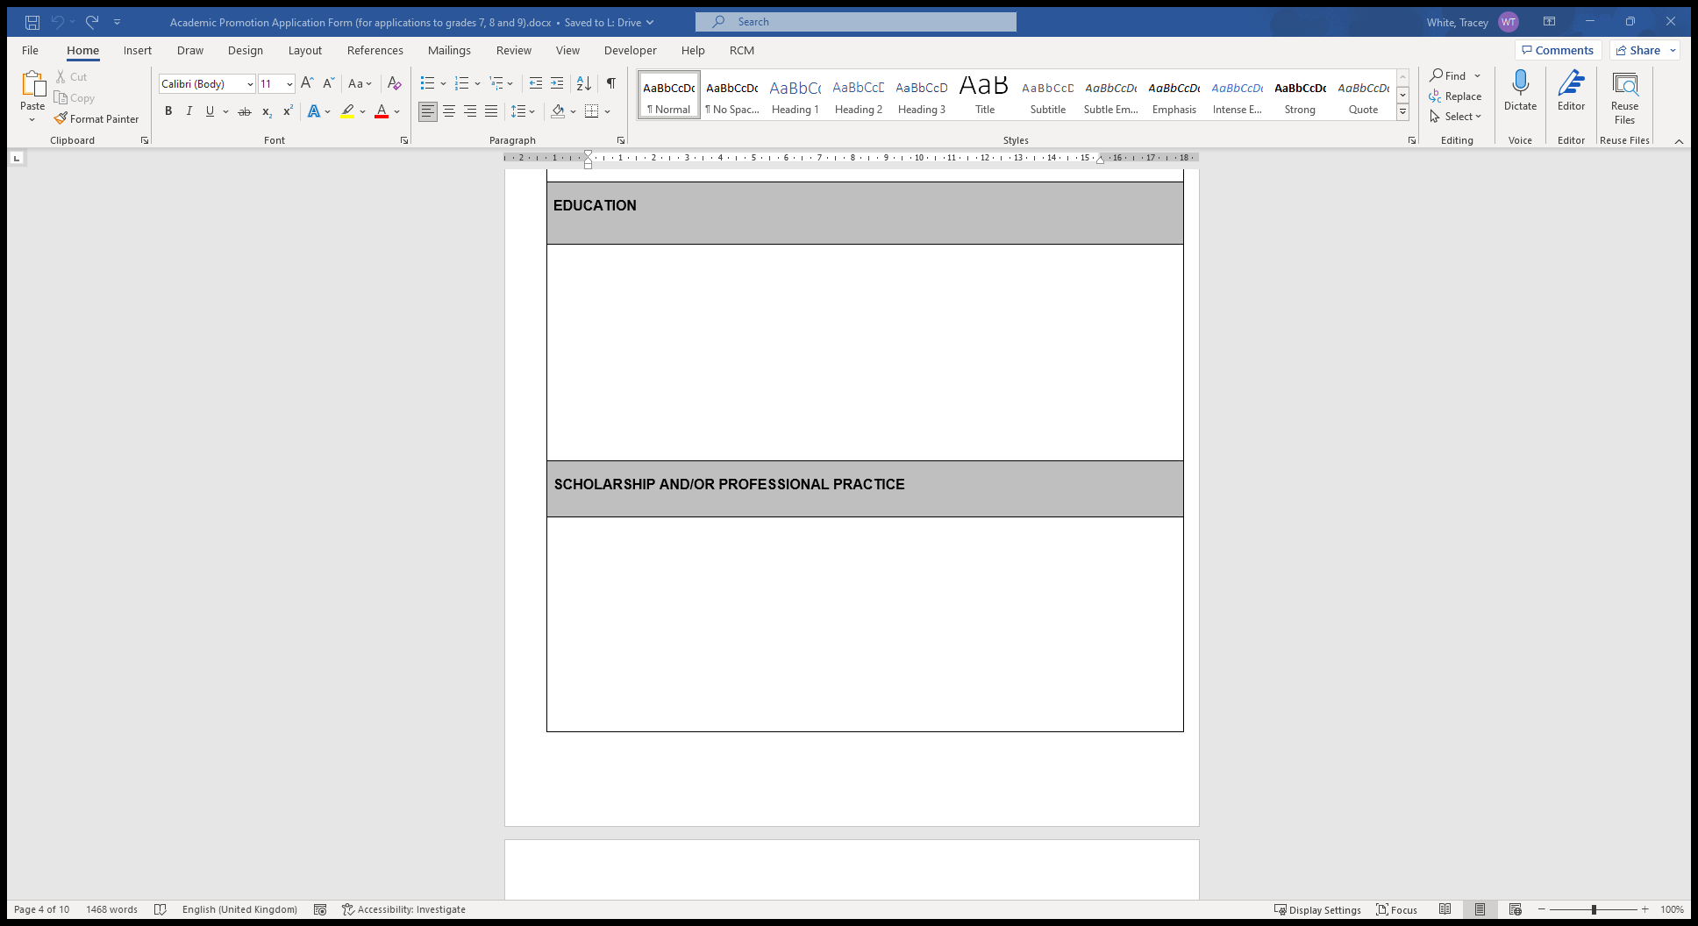

Slide 15
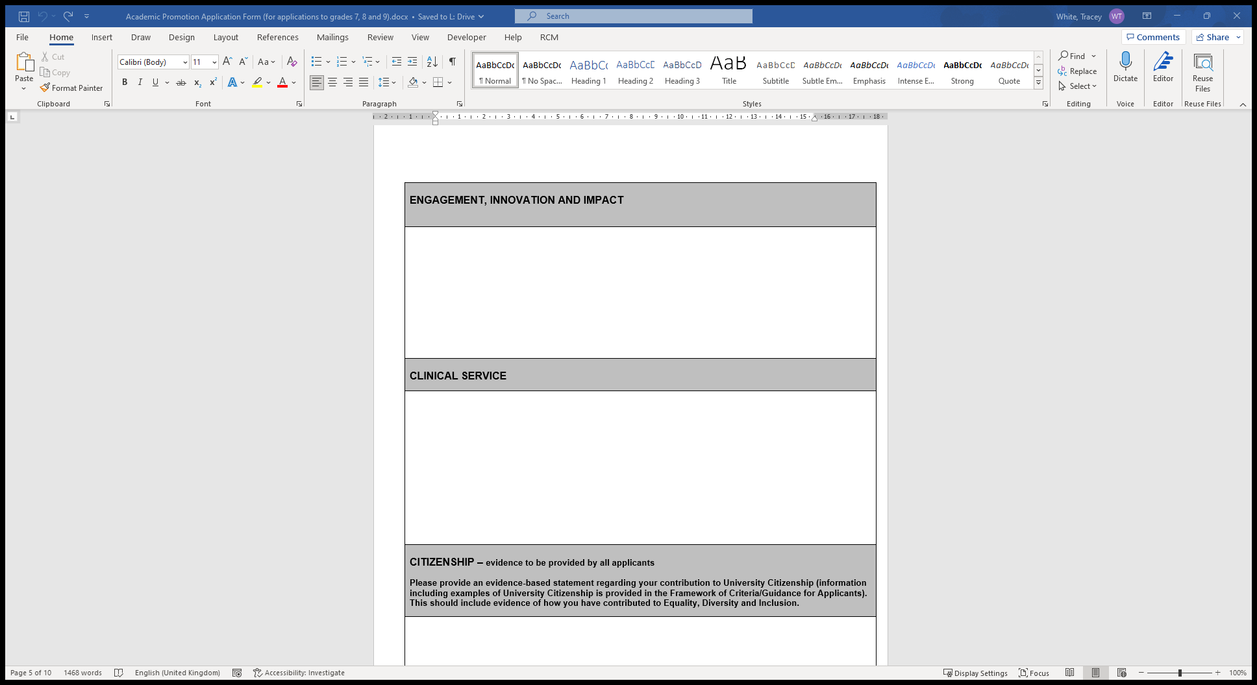
Remember all applicants have to provide evidence of Citizenship at a baseline level. Examples are included in the Framework. This must include information about your contribution to equality, diversity and inclusion

Slide 16
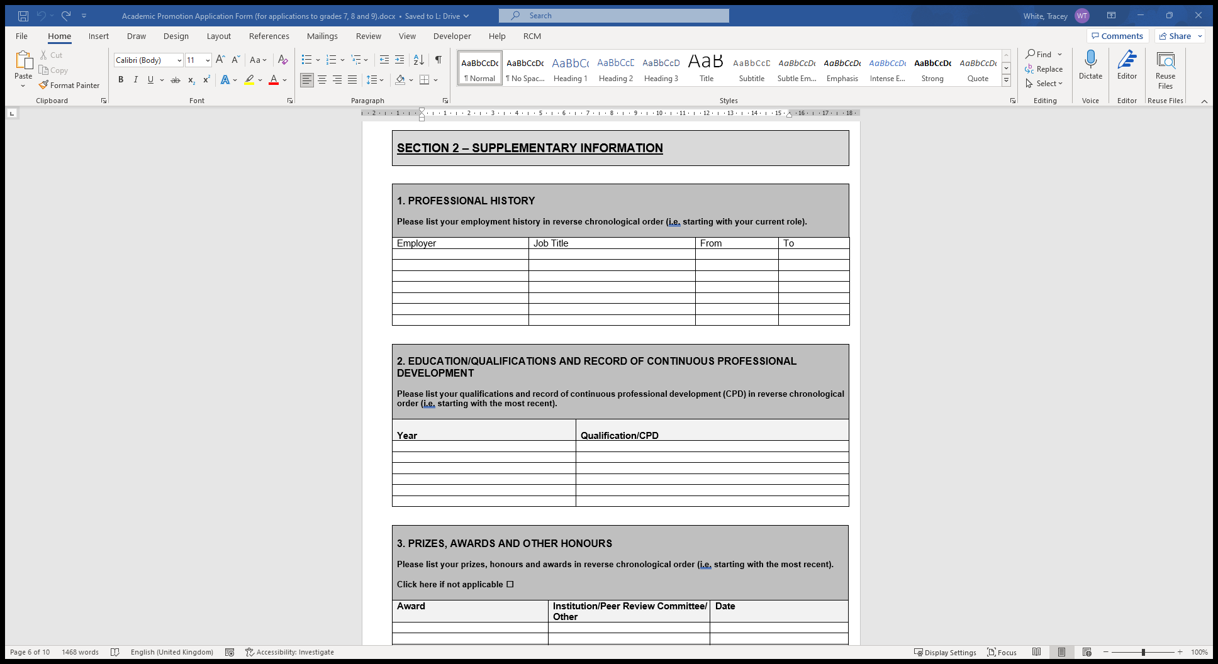
Section 2 is designed for you to provide information to back up what you have provided under Section 1.
Throughout this section prefix any new information since your last promotion with ‘New’.
Remember you can use PURE to cut/paste information into this section as appropriate.

Slide 17
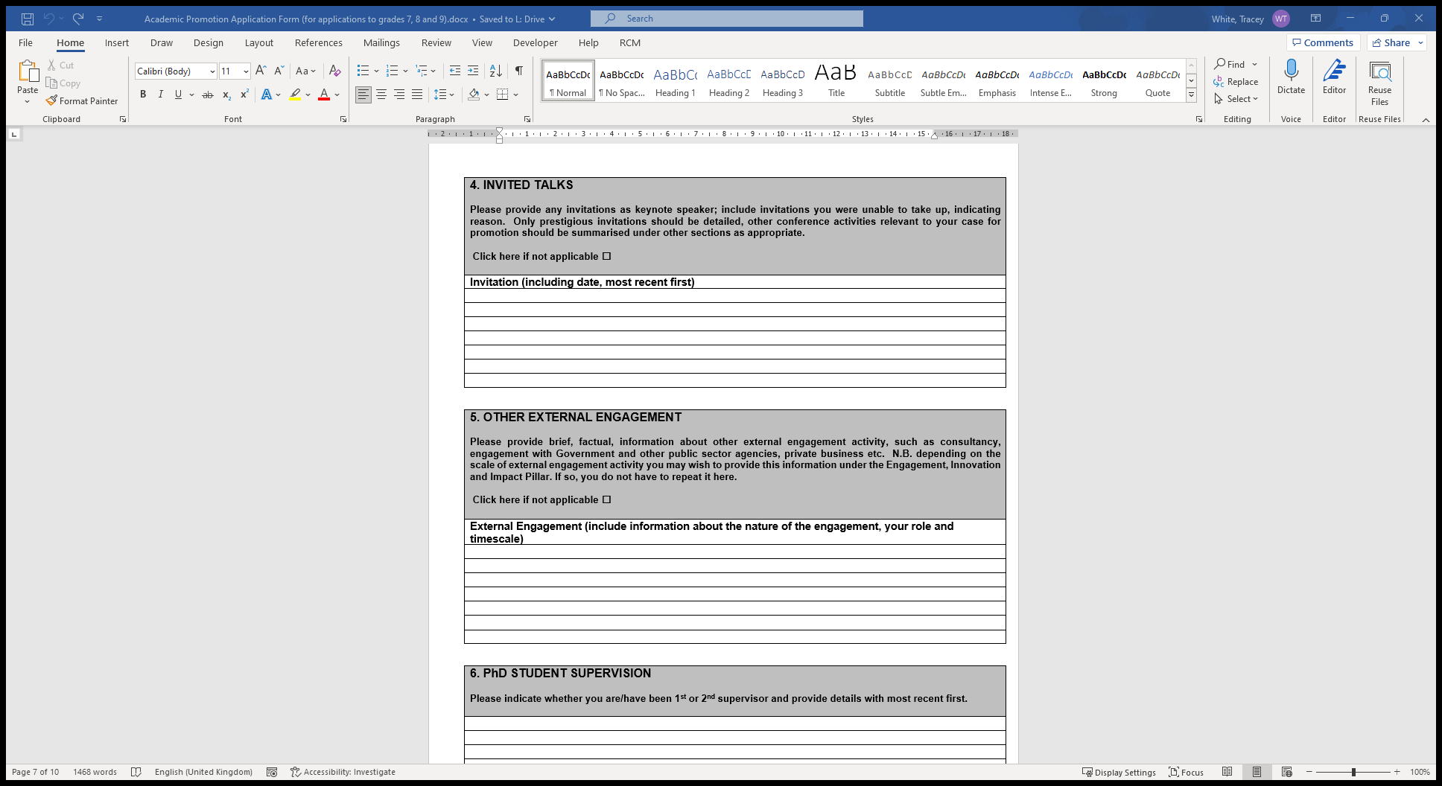

Slide 18
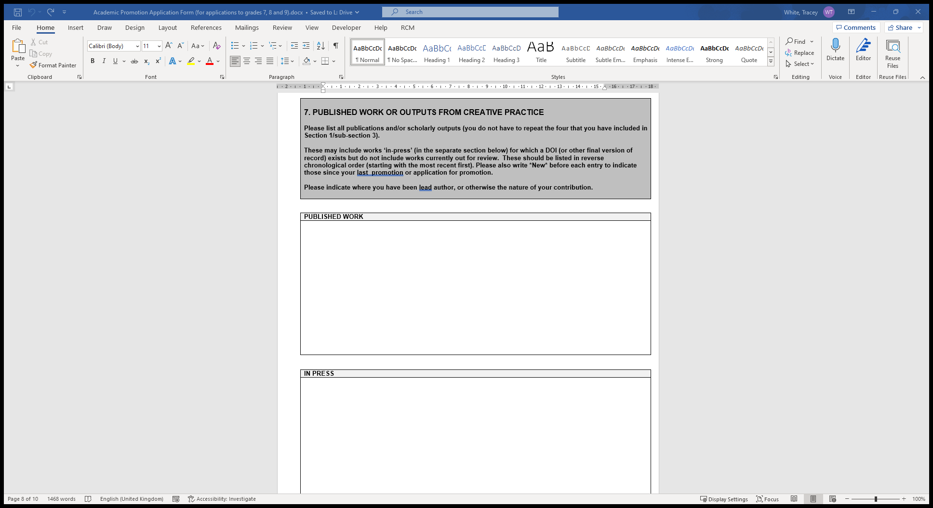

Slide 19
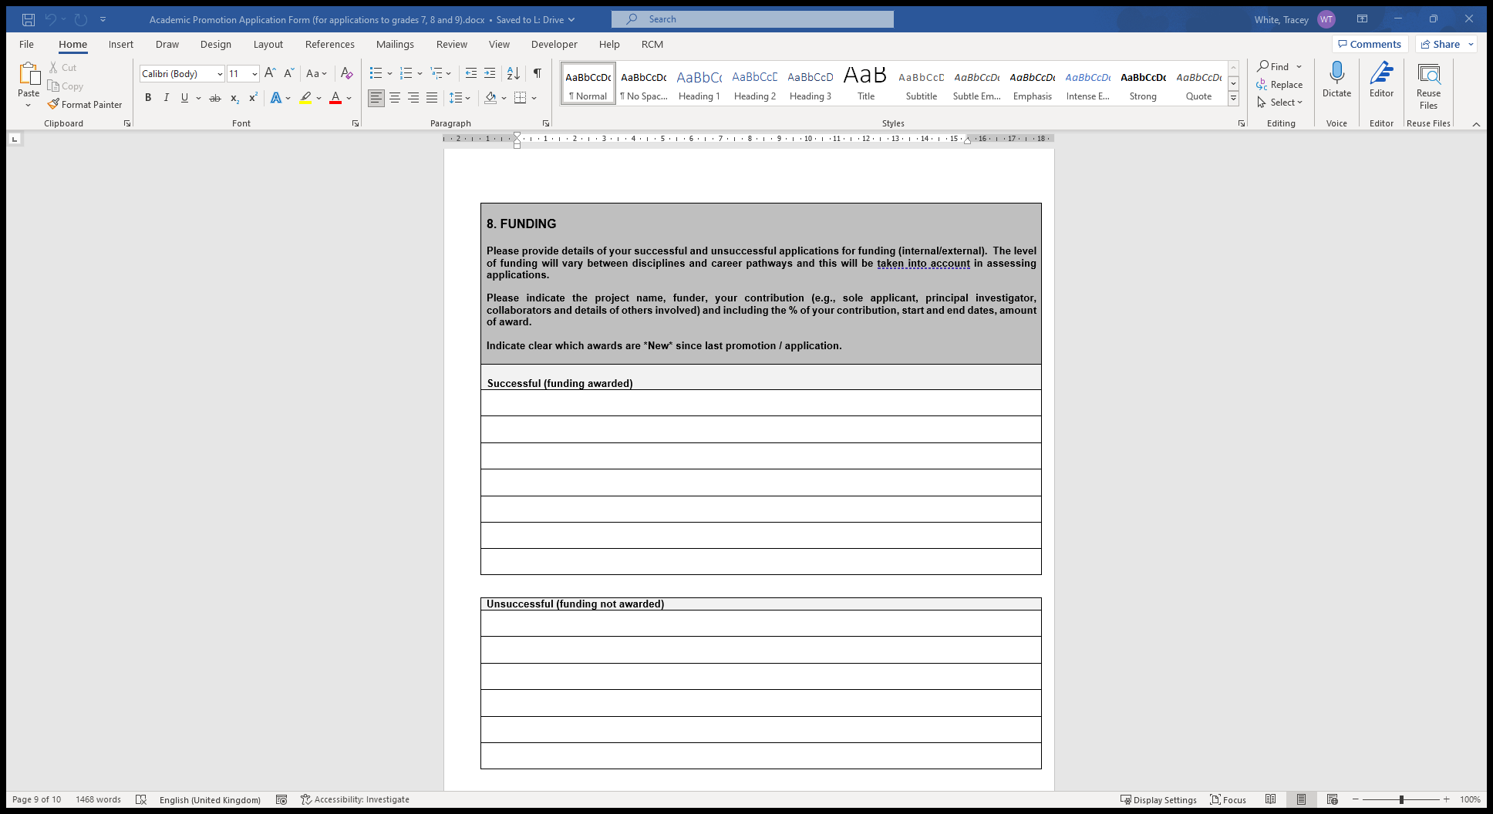

Slide 20
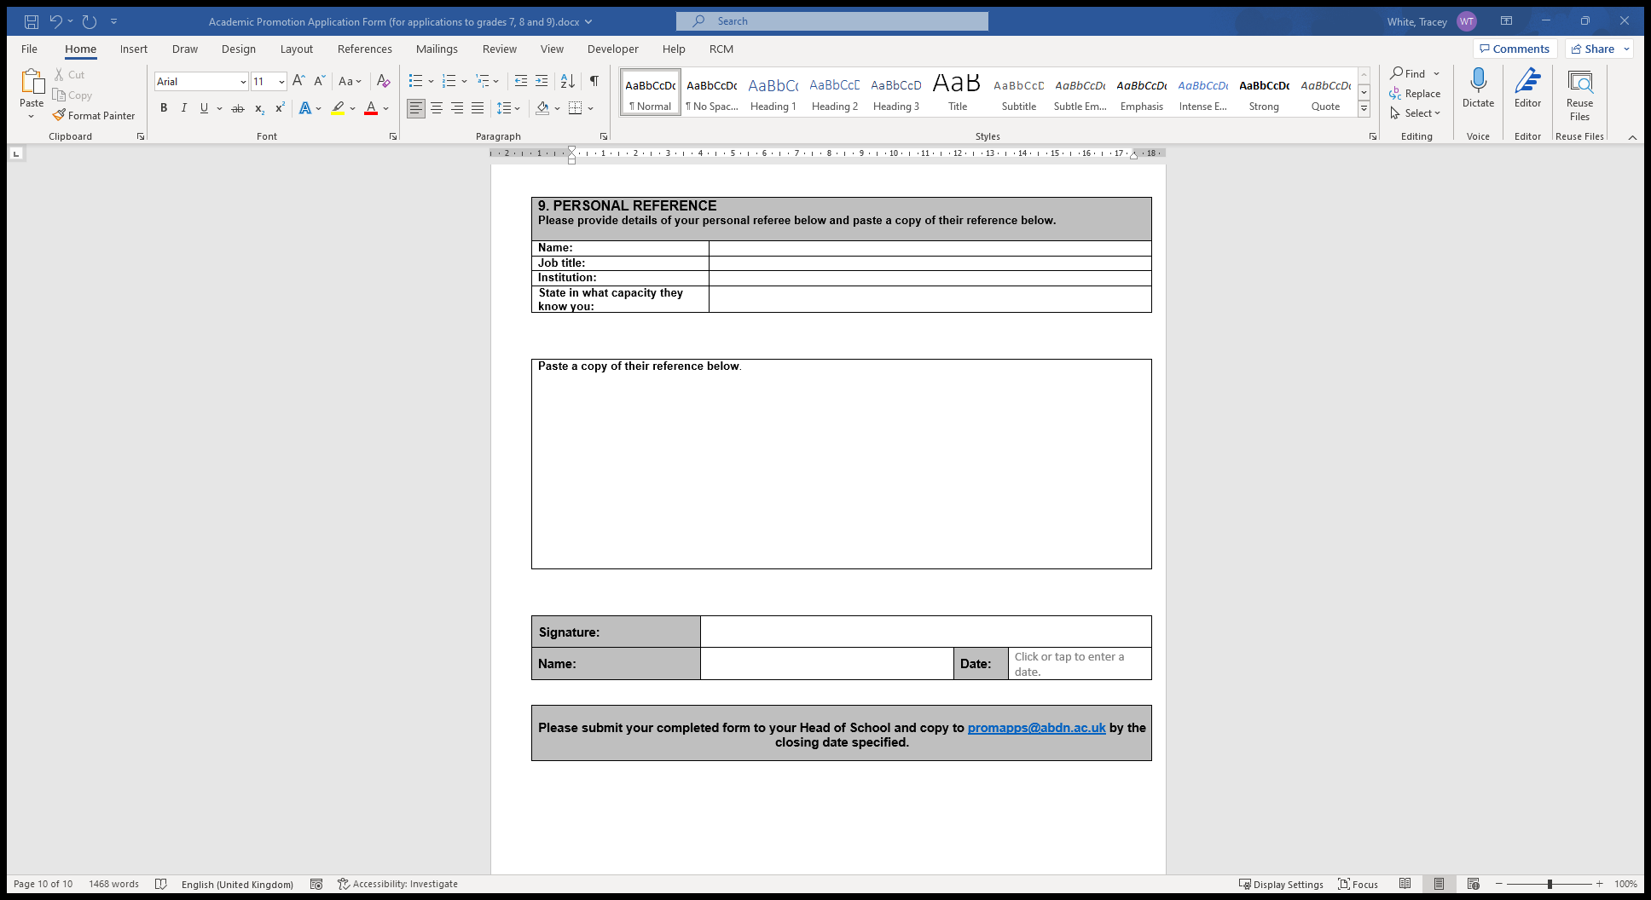
Choose a personal referee who really knows your work/ outputs and the impact they have had, and who can speak to your performance against disciplinary norms

Slide 21
Remember – if you are unsuccessful
Ensure you speak to your ALM/ Head of School to understand the feedback and how they can support you for a future application.

Slide 22
Where you can find more information
Academic Promotion Toolkit including Guidance for Applicants
Speak with your ALM/Head of School
Speak with HR

Slide 23
Questions?

